Slide 1
RE Update: Summer 2022 v2
Chris Allen, RE Adviser – Diocese of Norwich

Slide 2
RE Update Summer 2022
New regional RE hubs from September 2022:
Collaborate, innovate and support networking in RE.
Linked to Ofsted, DFE, Teaching Schools, Diocese, Universities and Las.
Cross phase working, cpd opportunities and research projects.

Slide 3
RE Update Summer 2022
NATRE Summary of Government work in RE 2016-2021
£0 funding for RE in last 5 years
10 years of low RE ITT training and recruitment of teachers
Reduction in GCSE and A level entries for RE
However 2021-22:
23% increase in entries for GCSE and A Level RE courses
100+ RE posts advertised in TES during May 2022

Slide 4
RE Update Summer 2022
RE in Society – survey results
64% of the adult population see an education that includes RE is important (RE used be ranked the lowest interest subject in schools).
2/3 of adults say it is important that we have RE as it helps us understand the beliefs of others.
Most adults agree RE prepares everyone to be independent critical thinkers who make sense of the diversity of belief in the wider world.

Slide 5
RE Update Summer 2022
The future of RE looks much better because:
Teacher training bursary for RE is being reinstated.
More schools are providing high quality provision by focusing on the expectations of the Commission on RE Report from 2018.
Ofsted is identifying schools who do not offer RE and is working with them to change this and ensure they comply with their statutory duties.

Slide 6
RE Update Summer 2022
NEW FREE RESOURCES

Slide 7
RE Update Summer 2022
https://jewishmuseum.org.uk/schools/in-the-classroom/inclusive-judaism/

Slide 8
RE Update Summer 2022
Religion and Worldviews (theschoolrun.com)
Notes:
A great article for parents to understand the teaching approach to Religion and Worldviews.
It covers:
What is Religion and Worldviews
What is a worldview
How RE is changing in schools and why
The curriculum children now experience in RE
A short video that summarises the Religion and Worldviews aproach

Slide 9
RE Update Summer 2022
https://www.natre.org.uk/about-natre/projects/

Slide 10
RE Update Summer 2022
www.natre.org.uk/news/latest-news/draft-handbook-for-the-religion-and-worldviews-in-the-classroom/

Slide 11
RE Update Summer 2022
https://teachers-talk.natre.org.uk/images-of-diversity-within-worldviews-breaking-the-bias/

Slide 12
RE Update Summer 2022
Culham St Gabriel’s has launched a new FREE online CPD library of short self study courses.
https://courses.cstg.org.uk
These include:
An introduction to Worldviews
Introduction to Curriculum
Introduction to Research
To undertake a course, you create a free login and off you go!

Slide 13
RE Update Summer 2022
www.therepodcast.co.uk
Great recent episodes on Philosophy, The Bible and Humanism.
Links to podcast hosts are on the website.

Slide 14
RE Update Summer 2022
https://www.open.edu/openlearn
Free RE courses to develop subject knowledge from 2hrs to 12hrs online.

Slide 15
RE Update Summer 2022
www.religion-online.org
Full text of articles and chapters organised by topic. Topics include Old and New Testament, Theology, Ethics, History and Sociology of Religion, Communication and Cultural Studies, Pastoral Care, Worship, Missions and Religious Education.

Slide 16
RE Update Summer 2022
A free resource to support diversity in primary school RE curriculums.
Focus for 2022-23 work.
https://committee.nottinghamcity.gov.uk/documents/s75036/Diversity%20of%20Religion%20and%20Belief%20-%20A%20Guidance%20and%20Resource%20Pack%20for%20Primary%20Schools%20in%20England%20and%20W.pdf

Slide 17
RE Update Summer 2022
www.bl.uk/sacred-texts

Slide 18
RE Update Summer 2022
Resources you can access and use for free from the Diocese of Norwich RE web pages.
www.dioceseofnorwich.org/schools/siams-re-collective-worship/religious-education/

Slide 19
RE Update Summer 2022
Created with DNEAT RE Ambassadors
Based on Judith Carter’s 7 Cs principles
Currently being piloted in all DNEAT academies
Showcased at RE Conference in July and national REXchange Research Conference in October 2022

Slide 20
RE Update Summer 2022

Slide 21
RE Update Summer 2022

Slide 22
RE Update Summer 2022

Slide 23
RE Update Summer 2022
Philosophy Exemplification Planning for EYFS – Yr6
Based on the big enquiry questions from the Norfolk Agreed Syllabus
Free to download with associated resources
www.dioceseofnorwich.org/schools/siams-re-collective-worship/religious-education/curriculum-planning/

Slide 24
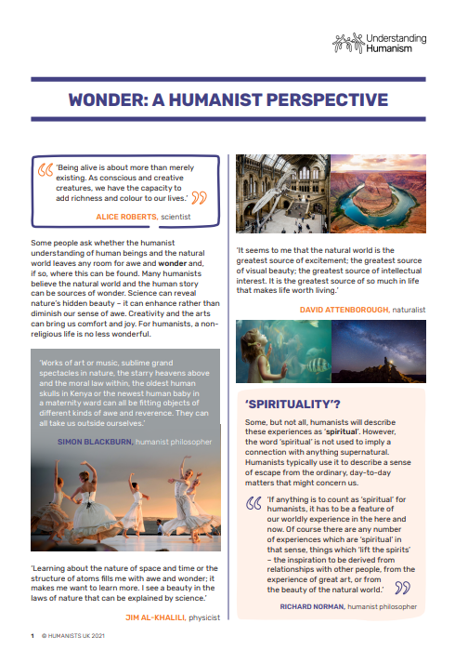
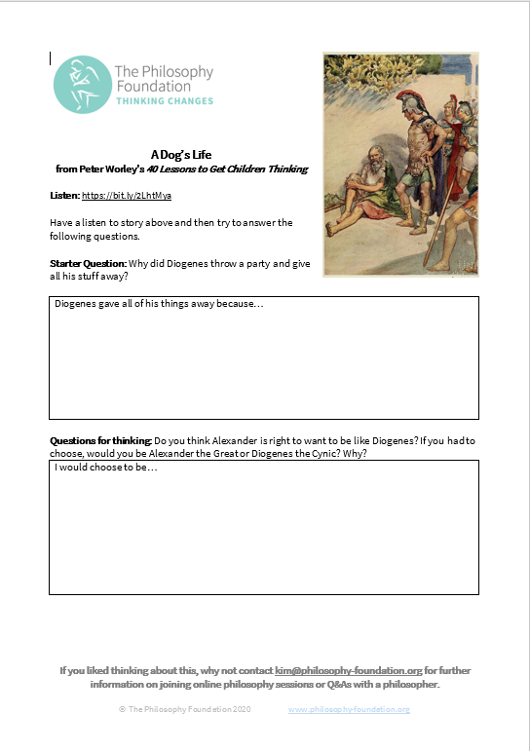
RE Update Summer 2022

Slide 25
RE Update Summer 2022
Foundation stage Philosophy is based on a book and concept: Noah and the Flood – Why do Christian’s trust God?
Foundation stage has continuous provision linked to areas of the EYFS profile, lots of oracy as well.
This is an additional unit to the three written for EYFS that focus on theology.

Slide 26
RE Update Summer 2022
RE Training for ALL schools and Academies 2022-23

Slide 27
RE Update Summer 2022

Slide 28
RE Update Summer 2022

Slide 29
RE Update Summer 2022
New RE Books for Summer 2022

Slide 30
RE Update Summer 2022

Slide 31
RE Update Summer 2022

Slide 32
RE Update Summer 2022

Slide 33
RE Update Summer 2022

Slide 34
RE Update Summer 2022
Thoughts for next year…
Ways of assessing RE support materials for each Agreed Syllabus Enquiry Question (Action Research Project).
Diversity, racial justice and decolonising your RE curriculum (Action Research Project).
A few facts about this year so far…
By July 2022 1170+ teachers trained in RE and 60+ Governors
Community Schools support has grown to 15 since September 2021 and rising
I will have now had contact with 84/109 of our schools this academic year

Slide 35
RE Update Summer 2022
Chris Allen
chris.allen@dioceseofnorwich.org
RE Adviser (Diocese of Norwich)
07818 336694

