Slide 1
RE Update: Spring 2023
Chris Allen, RE Adviser – Diocese of Norwich

Slide 2
RE Update Spring 2023
Key Messages – Mary Myatt Strictly RE 2023
Engage with the newest thinking and thinkers in RE – the next generation is important.
Use the original source, original image and authentic voice of religion and worldviews communities.
Invite speculation or representation in RE.
Respect tradition and provide insights into them.
Intellectual curiosity, deep thinking, deep questioning supports connections in learning in RE.
Authenticity in RE is crucial to adding significant value in RE.

Slide 3
RE Update Spring 2023
Key Messages – Mary Myatt Strictly RE 2023
Inclusion is the next focus in RE:
Fair access for all pupils no matter their starting points and learning needs.
Curiosity needs provoking to drive RE learning on. Be prepared to be surprised.
Diversifying our RE curriculum.
Look through the lens of vulnerability – if we get it right for the most vulnerable, we get it right for everyone.
RE & Reading:
Laden with stories that can provide the big picture, explore complex needs, enriches vocabulary and includes all.

Slide 4
RE Update Spring 2023
Key Messages – Mary Myatt Strictly RE 2023
Decolonising RE is the next step forward:
Use of images is really important.
Representation is key.
Keep and open heart and approach with humility.
Be sensitive and cautious in your choices – are we representing a faith group fairly? Do we make our pupil aware of different representations?
There are a range of approaches, don’t just jump in and start felling the trees – take time to watch them grow first!

Slide 5
RE Update Spring 2023
www.reonline.org.uk/research/research-of-the-month/an-approach-to-decolonising-religious-education/
Are there, could there be, or should there be links between the worldview agenda and curriculum decolonisation in RE?
What would decolonising the RE curriculum actually mean in practice, not just rhetorically?
Discuss and identify some ways in which your own RE curriculum could be decolonised: come up with two or three specific examples of changes that could be made. Think about content, but also approach.

Slide 6
RE Update Spring 2023
www.reonline.org.uk/research/research-of-the-month/an-approach-to-decolonising-teaching-about-jesus-in-primary-schools/
Are Jesus, angels and Christians often depicted as white-skinned and European in your RE resources?
Are you confident to teach children about Jesus’ Jewish context?
Do your teaching resources explore the diversity of Christian groups around the world?

Slide 7
RE Update Spring 2023
Practical Ways to Explore Racial Justice in RE and Beyond
This session is designed to explore what racial justice means in a theological, philosophical and social context within RE. How we can challenge viewpoints using practical resources within RE and expand pupil’s ideas and concepts. A range of resources and framework of ideas will be provided to schools to take away and try. Wider issues such as local, regional and global diversity will also be explored along with ways to challenge your thinking or f the content of your RE curriculum content to make it racially just. Links with Black History Month, Racial Justice Literacy and Collective Worship, will also be covered.
22 February 2023
1.30-4pm on ZOOM
£75.00
DofN.org/RacialJustice

Slide 8
RE Update Spring 2023
www.sikhmuseum.org.uk
A digital platform for Sikh exhibits.
Lectures on shared Sikh and British history.
Directory of relics and artefacts in public as well as private institutions.
Share common Sikh and British heritage in schools.

Slide 9
RE Update Spring 2023
www.resourcescentreonline.co.uk

Slide 10
RE Update Spring 2023
www.thereaderteacher.com

Slide 11
RE Update Spring 2023
Messages from Strictly RE 2023 – Ofsted
RE originally appeared in one strand Quality of Education, where Deep Dives are the expected feature of an inspection for RE. Deep Dives are reported under (looking at the 3 is – intent, impact and implementation).
More recently RE is increasingly featuring in the reporting of Personal Development. Personal Development – is the IMPACT and so what of RE as a subject.
Recent months has seen a big increase of activity around RE in inspections, comments now also appearing in Leadership – in terms of time, resources and support of leads to develop their subject properly, as well as CPD provision.

Slide 12
RE Update Spring 2023
Deep Dive:
Opening conversation with subject lead is about 45 minutes long, in depth and thorough based on curriculum, lesson planning, what should be seen / expected – before testing it out on a learning walk.
Learning walk – lead needs to narrate what is happening in lessons, remember SEND, adaptive learning, implementing curriculum intention and supporting most vulnerable are inspection gold threads. (Expect to move in and out of classes several times)
Pupil perception interview(s) – thorough and respectful of child. Lots of questions about the lesson, used prior learning (pupil books / floor books) and tracked back to check on recall of learning.
Follow up conversation with teachers about their sessions, CPD, upskilling staff, links to literacy and its impact on access to RE learning, place of RE in the curriculum etc. Importance of knowledge held by ALL STAFF involved in teaching RE.
Final conversation with subject lead to complete the cycle, discuss findings, query points and clarify. Checking pupil understanding, marking, feedback and assessment.

Slide 13
RE Update Spring 2023
Personal Development:
This is usually on day 2 of the inspection (Section 5)
focus on SMSC, British Values and pupils understanding of diversity, difference, similarities, global citizenship, protected values, oracy – high quality debate and discussion / wider reading.
Access for all – inclusivity is a key theme as well.
RE contributes to a great deal of the above for this section of the inspection.
Be prepared to answer and cite examples. Know what RE does and say it! Make it known.

Slide 14
RE Update Spring 2023
How do you mark and feedback in RE?
Ofsted RE Research Review May 2021
‘We should only assess in RE to ensure pupils get better at RE.’

Slide 15
RE Update Spring 2023
Ways of knowing
This assesses the methodologies / skills in RE.
It focuses on how to get to the substantive knowledge and connect it within the different disciplines.
Substantive knowledge
This assess the facts and key concepts related to religions and worldviews.
These need to be remembered in long term memory and retrieved when needed.
Disciplinary knowledge
These assess the different disciplinary concepts required to answer the enquiry question.
Each discipline has distinct knowledge that builds over time.

Slide 16
RE Update Spring 2023
Assessing Substantive & Disciplinary Knowledge in RE
Diocese of Norwich assessment Suite Pilot Spring / Summer 2023
March 23 – shared pilot resources
June 23 – feedback survey
July 23 – review and standardise
September 23 - publish
Emai: chris.allen@dioceseofnorwich.org
if you want to take part.

Slide 17
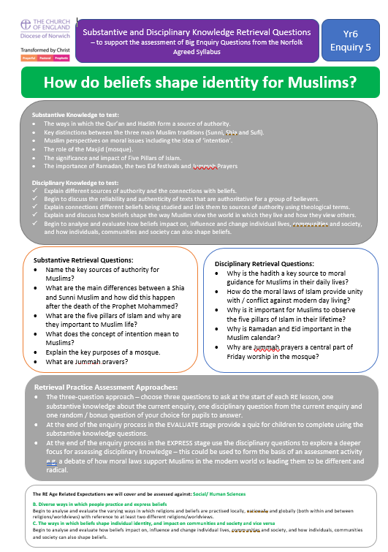
RE Update Spring 2023
Example

Slide 18
RE Update Spring 2023

Slide 19
RE Update Spring 2023
Ways of Assessing in RE –
Substantive Knowledge and Ways of Knowing
1 February 2023
2-4.30pm on ZOOM
£75.00
DofN.org/AssessingRE_Feb
This session will introduce staff to how we can assess in RE in a multi-disciplinary way. It will consider the pillars of knowledge Ofsted considers builds an RE Curriculum. It will focus on how we can assess Substantive Knowledge in RE in a meaningful way. The session will explore assessing the multi-disciplines in RE by building on the Ways of Knowing that forms the current Age-Related Expectations. It will also consider how we manage, challenge and begin to assess a child’s personal knowledge in RE. It will offer practical resources to explore how your school might assess substantive knowledge through the three disciplines as well as the ways to collect evidence to make firm judgements of pupil’s achievement and progress in RE.

Slide 20
RE Update Spring 2023
Teaching RE through the three disciplines of Theology / Philosophy / Social Human Sciences
21 March 2023 1.30-5pm at Diocesan House
£75.00 DofN.org.TeachingRE_Mar
This session is designed to introduce staff to teaching RE in a multi-disciplinary way. It will cross reference the pillars of knowledge Ofsted considers builds an RE Curriculum. It will explore Substantive knowledge, Ways of Knowing and Personal knowledge through a multi-disciplinary approach. It will offer practical resources to support the delivery of a scholarly and academically rigorous RE curriculum.
An invaluable training session to really get to grips with understanding what is expected in the teaching of effective RE.

Slide 21
RE Update Spring 2023
FREE online 4 hour RE Conference for EYFS and RE
3 March 2023 1-5pm
Book your ticket:
Effective RE / RVE for Early Years: 'Understanding the World' (AREIAC) Tickets, Fri 3 Mar 2023 at 13:00 | Eventbrite
Notes:
Session 1: 1pm—3pm :
1 -1.05 Welcome
1.05-1.35 Using Understanding Christianity in Early Years: Chris Allen, Norwich Diocesan RE Adviser
1.35-2.00 Spirituality and the Early Years: Sarah Holmes, Liverpool Hope University
2.00-2.30 SEND and Early Years: Sarah Payne
2.30-3.00 Belonging and Believing: Exploring the lived experience of individuals, families and communities through the lens of a five-year-old - Gill Vaisey, Books at Press
Session 2: 3pm—5pm:
3.00-3.45pm Assessing Progress in Early Years RE - Catriona Card, Berkeley Infant School
3.45-4.30pm In Conversation: RE / RVE in the Early Years Classroom - chaired by Julie Childs, Utterby Primary Academy
4.30 pm Top Tips
Reflection
End 5pm

Slide 22
RE Update Spring 2023
Coming soon…
RE and Worldviews Nursery Curriculum
Through story, play and experiences
Pilot Summer 2023 – get in touch if you want to be part of this amazing work!

Slide 23
RE Update Spring 2023
Resources to champion and advocate RE with parents
Culham St Gabriel’s Parent Survey 2022 found from a representative group of 2000 parents – 67% see RE as important and 78% say RE lessons help their children to learn about other beliefs.
Parents have genuine concerns about RE forcing a particular belief, biased teaching, not fully inclusive and lacking connection to jobs or further learning.
We need to be proactive with our parents and mitigate rather than just react to possible concerns or queries. Sometimes it is about misinterpretation of what RE actually is – start with your RE Curriculum Statement of Intent

Slide 24
RE Update Spring 2023
Personal development
Well being
Values & Morals
Transferable skills
Social benefit
Short films on Culham St Gabriel's that explore these aspects.
Policy Briefing papers for senior leaders including RE and Mental Health
Entering RE competitions to raise profile and showcase work
Use of pupil voice as advocates of RE

Slide 25
RE Update Spring 2023
4 projects to consider:
Celebrating the diversity within your parent community
Active engagement with other faiths in mono-cultural settings
Faith food cafes
RE and careers pathways (True Tube My Future, My Career, My RE)

Slide 26
RE Update Spring 2023
Challenges with the right to withdrawal:
Clear policy with intent of the subject (to mitigate and counteract issues)
Inclusive nature of RE
Showcase the benefits of the subject – why it is of great value? Pupil voice as advocates for RE.
Know the law
Use your SACRE/ RE Adviser/ NATRE to seek help
Listen. Don’t rush to respond.

Slide 27
RE Update Spring 2023
Multicultural Kingdom explores some of the causes and implications of ethnic diversity on the British Christian landscape - and the implications on the landscape of theology itself. Why, it asks, do we prefer to remain segregated in our ecclesiology? Why indeed, do several churches of different ethnic heritage use the same building for services on Sunday but do not get to worship together?
£12.00 (instead of £21.99) www.scmpress.hymnsam.co.uk

Slide 28
RE Update Spring 2023
Metacognition, Worldviews and Religious Education seeks to support teachers in creating a new and exciting classroom approach. With a focus on putting children and teachers’ worldviews back on the RE agenda and developing awareness of these through metacognitive processes, it includes
Tables, frameworks and checklists to make it easy for teachers to adapt the approach to their own context
Concrete examples of how the approach can work in the classroom, including case studies from teachers
Call-out boxes for teachers and others to reflect on their own practice and to consider their own beliefs and values in relation to teaching and learning
£21.99 on AMAZON

Slide 29
RE Update Spring 2023
Mastering Primary Religious Education introduces the primary religious education curriculum and helps trainees and teachers learn how to plan and teach inspiring lessons that make religious education irresistible.
Topics covered include:
Current developments in religious education
Religious education as an irresistible activity
Religious education as a practical activity
Skills to develop in religious education
Promoting curiosity
Assessing children in religious education
Practical issues
This guide includes examples of children's work, case studies, readings to reflect upon and reflective questions that all help to show students and teachers what is considered to be best and most innovative practice, and how they can use that knowledge in their own teaching to the greatest effect.
£18.99 AMAZON

Slide 30
RE Update Spring 2023
What would you like to see in the RE training offer for 2023/24?

Slide 31
RE Update Spring 2023
Understanding Humanism – A Curriculum Resource in RE
1 March 2023 1.30-4pm Diocesan House
£75.00
DofN.org/UH
This session is designed to support teachers of RE who shall be delivering Humanism units of work as part of their school curriculum. The Norfolk Agreed Syllabus expects religion and organized non-religious world views to be taught in schools. In the session, we will explore some of the Agreed Syllabus units that focus on Humanism. We will look at the Understanding Humanism resource, we will consider the main elements of Humanism to be taught, the resources available and creative ways to gain the most from pupils in the classroom.

Slide 32
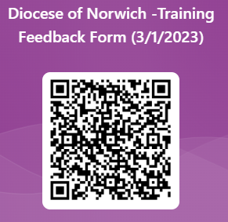
RE Update Spring 2023
Chris Allen
chris.allen@dioceseofnorwich.org
RE Adviser (Diocese of Norwich)
07818 336694

