Slide 1
RE Update October 2022
Chris Allen, RE Adviser – Diocese of Norwich

Slide 2
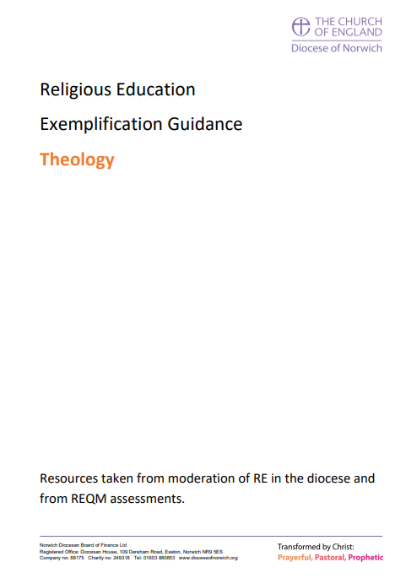
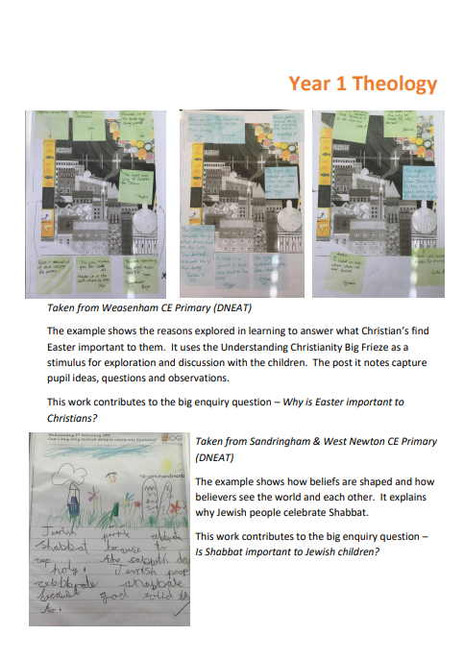
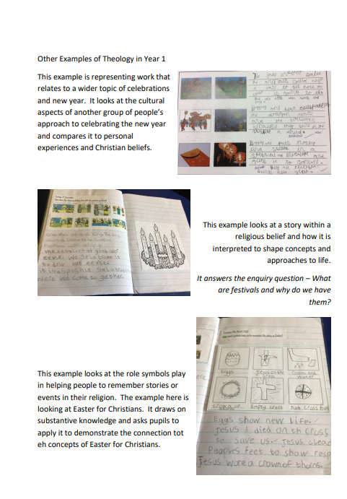
RE Update October 2022
Diocese Exemplification Documents

Slide 3
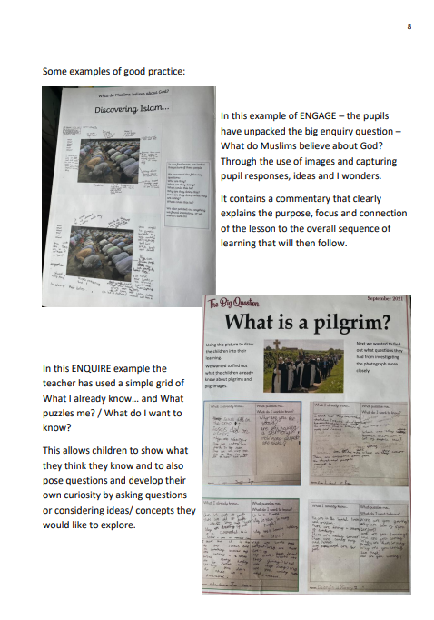
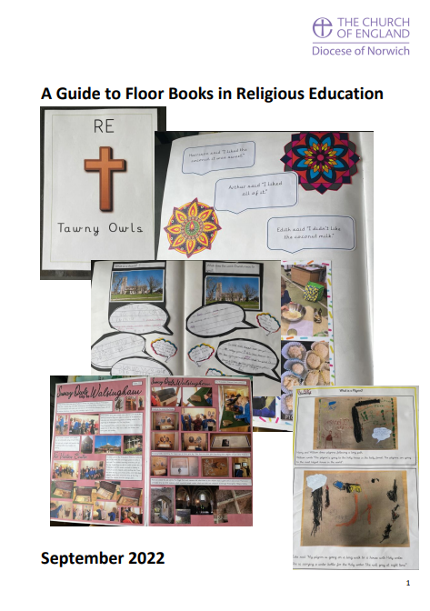
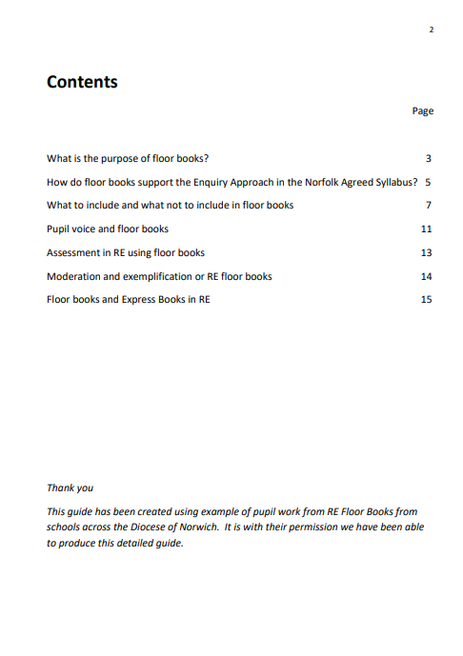
RE Update October 2022
Diocese Guide to Floor Books in RE

Slide 4
RE Update October 2022
Notes:
£135 for two days, early bird £15 off + NATRE membership discount of a further £25 – making cost £95 for two days plus all sessions recorded with handouts available for 12 months afterwards + two weeks of 1 hour twilights before the weekend conference. AMAZING DEAL!

Slide 5
RE Update October 2022
The validation of knowledge in Religion and Worldviews
are-we-what-we-eat-card2-combined.pdf (natre.org.uk)

Slide 6
RE Update October 2022
@RE_Today
@RECouncil

Slide 7
RE Update October 2022
Monday 17th October 4-4.40pm In conversation with Professor David Clough and Scarlett Hayward Theme: Christian ethics, animal welfare and the religion and worldviews classroom
Monday 21st November 7-7.40pm In conversation with Professor Trevor Cooling and Dr Kate Christopher Theme: Understanding Understanding! What do we mean by understanding?!
Monday 19th December 4.30-5.10pm In Conversation with Dr Kevin O’Grady Theme: Conceptualising religion and worldviews for the school
www.cstg.org.uk/activities/events/in-conversation/

Slide 8
RE Update October 2022
www.reonline.org.uk/professional-development/free-self-study-courses/

Slide 9
RE Update October 2022

Slide 10
RE Update October 2022

Slide 11
RE Update October 2022
A great book to get your head around multi-disciplinary RE. It gives you the background tot eh thinking as well as practical examples.

Slide 12
RE Update October 2022
New RE Video from Theos – Worlds Apart
Focus on Science and Religion
https://youtu.be/SXXj_YB--_g

Slide 13
RE Update October 2022
New Theos Report
Science and Religion, moving away from the shallow end
https://www.theosthinktank.co.uk/cmsfiles/Science-and-Religion-Moving-away-from-the-shallow-end_REPORT.pdf

Slide 14
RE Update October 2022
New promotional videos about RE launched by Culham St Gabriel’s
https://www.cstg.org.uk/campaigns/promoting-an-education-in-rwv/promotional-film-collection/
Great to promote religion and worldviews with parents, staff and pupils.

Slide 15
RE Update October 2022
What is Inter Faith Week?
Highlights the good work done by local faith, inter faith and faith-based groups and organisations
Draws new people into inter faith learning and cooperation
Enables greater interaction between people of different backgrounds
Helps develop integrated and neighbourly communities
Celebrates diversity and commonality
Opens new possibilities for partnership
www.interfaithweek.org
Notes:
Aims of the week:
Strengthening good inter faith relations at all levels
Increasing awareness of the different and distinct faith communities in the UK, in particular celebrating and building on the contribution which their members make to their neighbourhoods and to wider society
Increasing understanding between people of religious and non-religious beliefs

Slide 16
RE Update October 2022
Resources
LEARNING ABOUT INTER FAITH ACTIVITY: A PRIMARY RESOURCE FOR PUPILS AGED 9–11
INTER FAITH ACTIVITY IN THE UK: A TEACHER RESOURCE FOR SECONDARY PUPILS AGED 11-14
SCHOOL ASSEMBLIES/ COLLECTIVE WORSHIP
Interfaith Week activities for Primary / Secondary Schools produced by natre

Slide 17
RE Local Leaders
Sharing Good Practice / Resources

Slide 18
RE Update October 2022
Chris Allen
chris.allen@dioceseofnorwich.org
RE Adviser (Diocese of Norwich)
07818 336694

