Slide 1
RE Update for Local Leaders of RE
January/ February 2022
Chris Allen – Diocese of Norwich RE Adviser

Slide 2
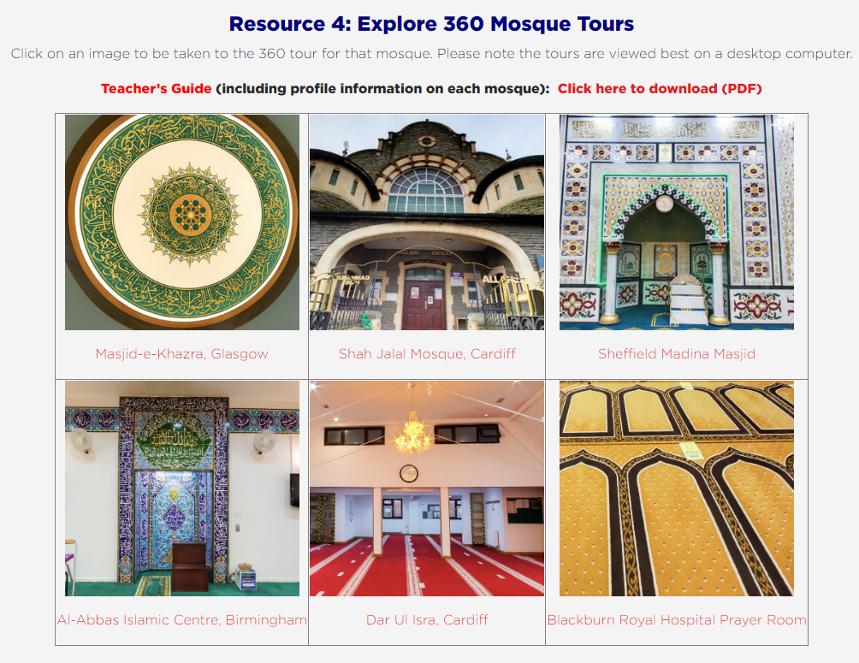
RE Update January/ February 2022
Virtual RE Resources
https://www.visitmymosque.org/for-re-teachers/#360tours

Slide 3
RE Update January/ February 2022
Virtual RE Resources
https://www.visitmymosque.org/for-re-teachers/#recordedtours

Slide 4
RE Update January/ February 2022
Virtual RE Resources

Slide 5
RE Update January/ February 2022
Virtual RE Resources

Slide 6
RE Update January/ February 2022
Remote Learning – Supporting High Quality RE
Year Group | Focus | Number of Lessons | Suggested links to Norfolk Agreed Syllabus
Year 1 | The Nativity | 7 lessons | Yr2 Enquiry 2
Year 2 | Judaism | 10 lessons | Yr1 Enquiry 1, Yr1 Enquiry 3, Yr2 Enquiry 1, Yr2 Enquiry 4
Year 3 | Christianity | 10 lessons | Yr3 Enquiry 2, Yr3 Enquiry 1, Yr2 Enquiry 3
Year 4 | Islam | 10 lessons | Yr4 Enquiry 5, Yr5 Enquiry 2, Year 6 Enquiry 5
Year 5 | Buddhism Humanism | 10 lessons 10 lessons | Yr5 Enquiry 3 Yr5 Enquiry 1 Year 6 Enquiry 3 and 4
Year 6 | Sikhism Hinduism | 10 lessons 10 lessons | Yr4 Enquiry 2 Yr4 Enquiry 3 Yr6 Enquiry 6 (change focus from Islam)

Slide 7
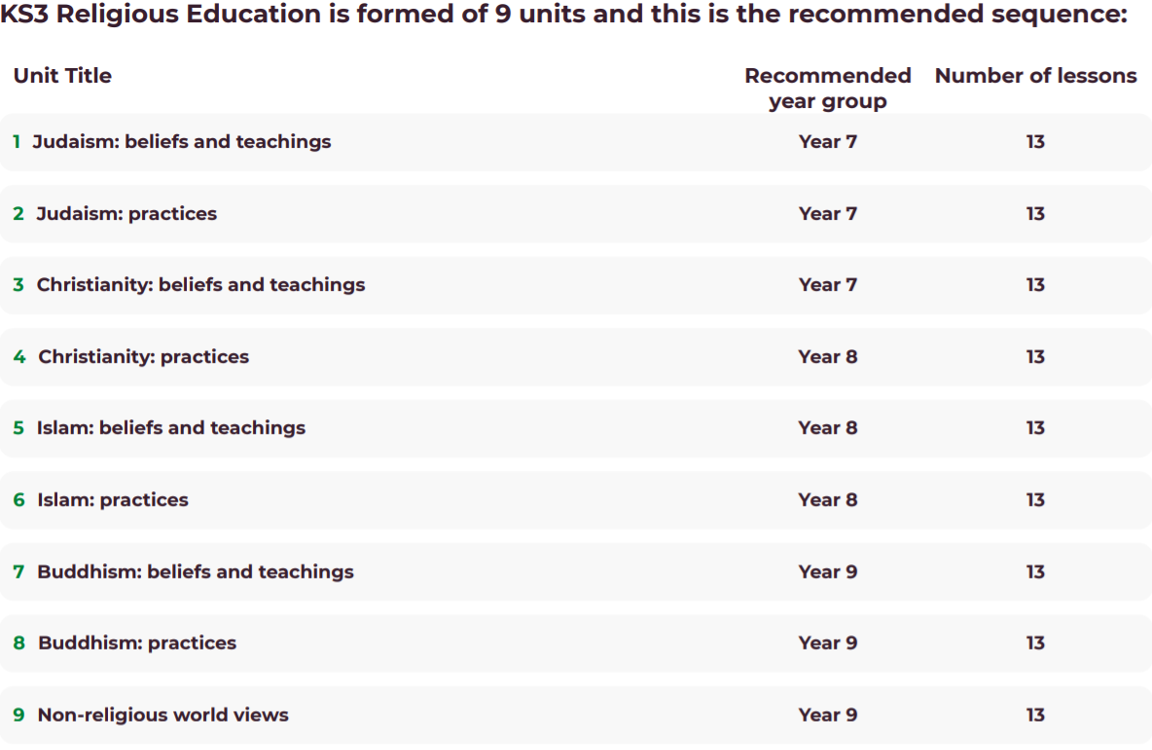
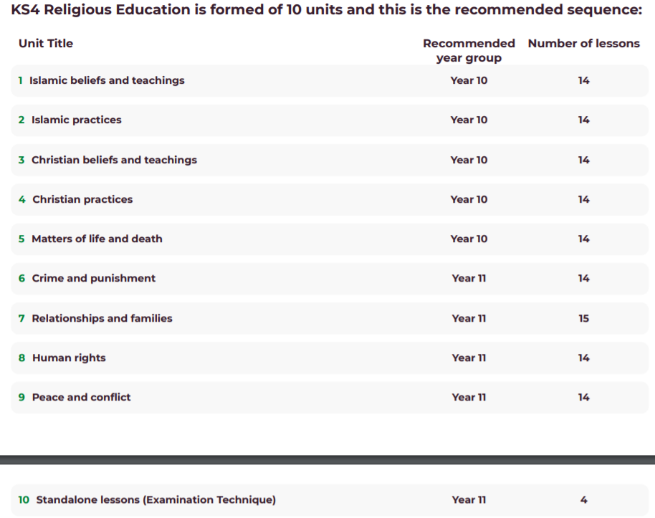
RE Update January/ February 2022

Slide 8
RE Update January/ February 2022
https://understandinghumanism.org.uk/
Website has been updated with over 100 new downloadable resources for teaching Humanism within RE.

Slide 9
RE Update January/ February 2022
This new page on the REC website hosts a series of resources relating to worldviews.
It includes a new animation from Jason Ramasami, well known animator and former RE teacher, that captures the key characteristics of how this new approach represents religions in the classroom. A bibliography from Dawn Cox of articles, blogs and other material that have been published in response to the CoRE Report and a series of FAQs.
www.religiouseducationcouncil.org.uk/worldviews

Slide 10
RE Update January/ February 2022
EYFS RE Tool
Possible future trial from AREIAC Executive Member Jan McGuire
Upskilling teachers
Deep and rich planning resources
Let Chris Allen know if you would be interested and who to contact in your setting.

Slide 11
RE Update January/ February 2022
Update from SACRE
Norfolk RE Conference: 8 July 2022, hopefully fully funded by SACRE.
RE Today leading it – focus on multi-disciplinary RE and subject knowledge.

Slide 12
RE Update January/ February 2022
www.reonline.org.uk/research/rexchange-2022/
Range of national keynote speakers.
Range of practical and relevant workshops taken from research in classrooms, schools and RE contexts from grant funded projects and open research papers.
Panel type discussions on current RE themes.
Book a FREE place at: www.eventbrite.co.uk/e/rexchange-2022-tickets-250007337677

Slide 13
RE Update January/ February 2022
AREIAC Early Years and RE Conference ‘Voices in the Region’.
FREE EVENT – Online (Nov 2022)
Regional conference for South/ South East / East of England

Slide 14
RE Update January/ February 2022
RE and Inspections
https://educationinspection.blog.gov.uk/2021/12/08/curriculum-keeping-it-simple/
Inspectors carry out ‘deep dives’ on inspection; they’ll gather evidence on the intent, implementation and impact of the curriculum.
A subject deep dive will explore whether pupils have been taught and have learned the curriculum content they need to achieve the goals that schools have for their education.
If pupils don’t succeed in learning what we hoped then they have knowledge gaps that will be preventing that success
When pupils are not successful, this is sometimes because the knowledge they need was not identified and taught to them.
It might be obvious if there are gaps in the teaching of mathematics but often pupils can be asked complex questions in foundation subjects without the depth of knowledge that would allow them to provide a meaningful answer.
Sometimes, the knowledge that pupils need has been taught but perhaps not given the necessary emphasis or not repeated often enough to ensure that they learn it for future use.
A second blog has just been released with a specific focus on primary school deep dives.

Slide 15
RE Update January/ February 2022
Other RE Resources and NEW Books
EYFS / Yr1 – Belonging and Believing series by Gill Vaisey
The Belonging and Believing Project reflects the lived experience of individuals and communities and aims to inform, inspire, engage and excite children, teachers, and everyone interested in understanding and respecting diversity of religion and worldviews.
Families reflecting Buddhism, Christianity, Hinduism, Sikhism, Judaism, the Báhá’í faith, Islam and humanism are featured and reflect some lesser known traditions and expression of beliefs.
Available to order at: www.booksatpress.co.uk/belongingandbelieving.html

Slide 16
RE Update January/ February 2022
If you want to tell more stories in the classroom but lack the confidence to do so... If you need guidance finding stories that are good to get children thinking... If you like using stories in your teaching but want to get more from them than the moral at the end... Once Upon an If is the book for you!

Slide 17
RE Update January/ February 2022
The If Machine, presents 30 clear, ready-to-use plans to teach philosophy in the classroom with children aged five to 13. Each tried-and-tested session offers an imaginary situation, followed by a series of questions to encourage children to challenge key philosophical ideas such as values and ethics, gender and identity, and existence and beauty.
With a star system indicating the level of difficulty.

Slide 18
RE Update January/ February 2022
Please share when visiting schools the RE Chat that is the first Monday of each month (term time) 8-9pm on Twitter hosted by NATRE.
Excellent informal network of sharing ideas and practice. You can follow the feed the next day if you can’t attend

Slide 19
RE Update January/ February 2022
Another fantastic conference weekend!
Norfolk’s Agreed Syllabus was mentioned in the final keynote address.
Lots of free take away resources.
Attached is the NATRE website guide.

Slide 20
RE Update January/ February 2022
RE training offer September 2022- July 2023
Understanding Christianity – 1 day core training rather than 4 half days.
RE Subject Knowledge 7 x 1 hour sessions on Zoom (with option of a pre-record), covering all of the main religions and worldviews of the Norfolk Agreed Syllabus.
Teaching RE through the three disciplines, 1 day core training offer.
Is your RE inspection ready? (Moving to focus on Ofsted and SIAMS)
Keeping Subject Leader Toolkit
RE for ECTs and RE for ECTs+1
Racial Justice teaching resources through RE
RE Curriculum Development – Review, Refresh and Renew – a practical session for schools
Assessing Substantive Knowledge in RE – half day workshop
Global Neighbours / REQM half day workshops to draft evidence forms and look at best practice examples.

