Slide 3
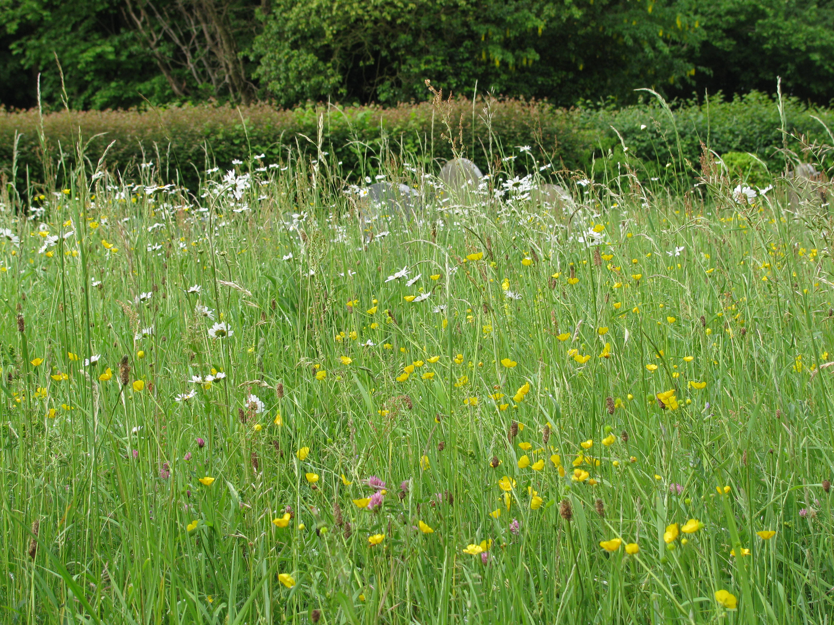
1990: The start of the journey?

Slide 4
The journey to Eco Church
For me: 1972 Limits to Growth; 1973 Small is Beautiful; 1978 Rich Christians in an Age of Hunger; post-war thriftiness; 4 kids under 5 on a single income! And always an important feature of discipleship.
2004: Hethel Church commitment to community outreach. “Hethel Specials” often with rural connection (Plough Sunday, Rogation, Harvest …) publicised to the community
2012 – 2016: kitchen and toilet project, including ‘trench-arch’ drainage
Easy impacts: Toilet Twinning; FairTrade Church; Ecotricity; LEDs; recycled paper; generosity; hospitality; ethical banking
2016: Huge ‘sustainability weekend’
The incongruity, ineffectiveness and expense of free-standing LPG heaters
Plus desire to make the church more useful for other events: Kitchen ü, Loo ü, Heating X, parking X, sound X.
2019: Let’s see what happens if we answer the Eco Church questionnaire.

Slide 5
The present challenges of environment and economy, of human development and global poverty, can only be faced with extraordinary Christ-liberated courage. … Actions have to change for words to have effect.
Archbishop Justin

Slide 6
What sort of “heating”?
2nd Sunday in the month 8.30am Holy Communion
Regular but occasional ‘Hethel Specials’
Future:
Coffee, croissants and news?
Midweek evening reflective service?
Visitors: ‘the congregation we don’t see’?
All point to ‘instant impact’ rather than 24/7 heating

Slide 7
Sustainable energy sources?
For us, #1 principle: sustainability must rule over cost – of installation or of running. Which means:
Bio fuel of some sort (logs, woodchip, straw, grass, biogas)
Electricity generated from renewables (solar, wind, hydro, tidal)

Slide 8
Biofuel?
Very expensive to install an automatic system
Space (for the boiler) and maintenance implications
Major implications regarding space for the heat output system
75% of woodchip comes from the US (at what transportation cost?)
Drax: The Green Energy Scandal exposed – Panorama BBC One 3rd October and on iPlayer afterwards https://www.bbc.co.uk/programmes/m001cw6z
Not viable

Slide 9
Electricity
If energy is to come entirely from renewable sources by 2050, the fraction that is transmitted electrically will need to triple?
To opt for electricity now is a ‘good thing’.
It’s also clean, flexible, and dry.

Slide 10
Electrical heating systems
High price is driven by the inefficiency of coal and gas power stations
Small churches may only have a single phase, 100A / 24kW power line
High-level radiant; Under-pew heaters; Distributed fan heaters
Air- or ground-source heat pumps
Coefficient of performance (CoP) typically between 3 and 4
10kW electricity gives 35kW heat
Brings energy costs down to the level of gas, and …
Probably avoids the cost of installing a 3-phase supply
GSHP tricky in a churchyard

Slide 11
And?
Messrs Secker and Sons Ltd installed the system in February 2018.
Visually it is better than anticipated (clever installers).
The compressor units on the chancel roof are barely audible even when running at maximum.
The fan-assisted heaters in the church are noisier than anticipated, but have four fan settings and can be ‘managed down’ for a quiet service.
Measured running costs are no higher than expected, typically 14kW = £4.50 per hour at present (inflated) energy costs
It has coped well with the winters since. Warm, not ‘toasty’; the cold floor has an effect below waist level and, as expected, less output in very cold weather.
Nevertheless overall we are very happy!

Slide 20
Challenges?
Time, time, time. One person doing it. You need a champion (or a small group), but a team will make a huge difference.
Getting the design right without much in the way of precedent for this kind of use of air-air heating. (online faculty system;
DAC overall very helpful
Seckers unbelievably patient, supportive and collaborative
Natural England incredibly cautious and inert, slowed up both faculty and planning permission
The funding took time and effort, but was not difficult
Is it a bit like Ukraine? Believing in what you’re doing is a powerful motivator.

Slide 21
www.acny.org.uk/hethel has a fuller PowerPoint presentation together with the report we submitted as part of the faculty application.

Slide 22
Funding (£12.5k)
A prayerful, generous local supporter
Our own fund-raising
British Airways Carbon Fund
Pray and “let your needs be known”
Make everything community-focussed / Earn funds through service to the community
https://www.dioceseofnorwich.org/articles/pcc-news/issue-25/finding-green-grants-for-your-environmental-project/
https://churchgrants.co.uk
https://www.parishresources.org.uk/wp-content/uploads/Charitable-Grants-for-Churches-Jul-2020.pdf

