Slide 1
Using Solar Power to decarbonize the Church
A brief introduction to the practicalities and barriers to solar power in Churches

Slide 2
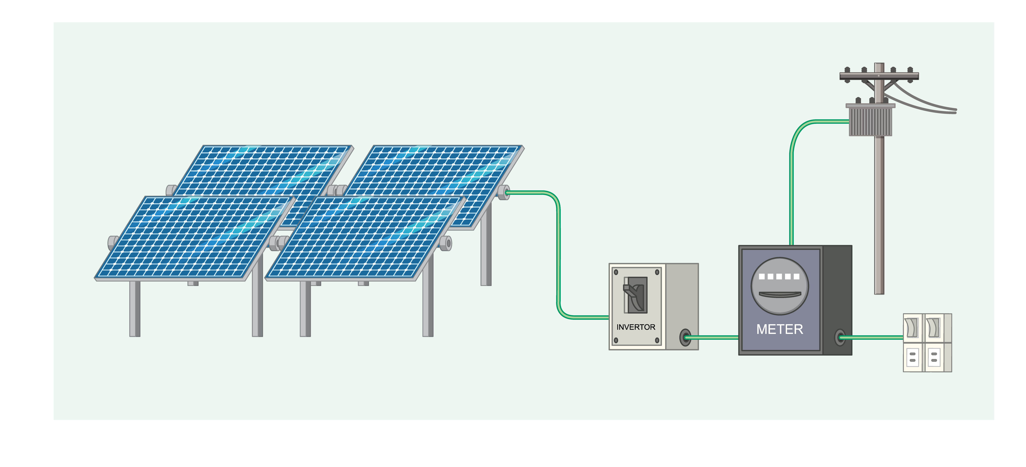
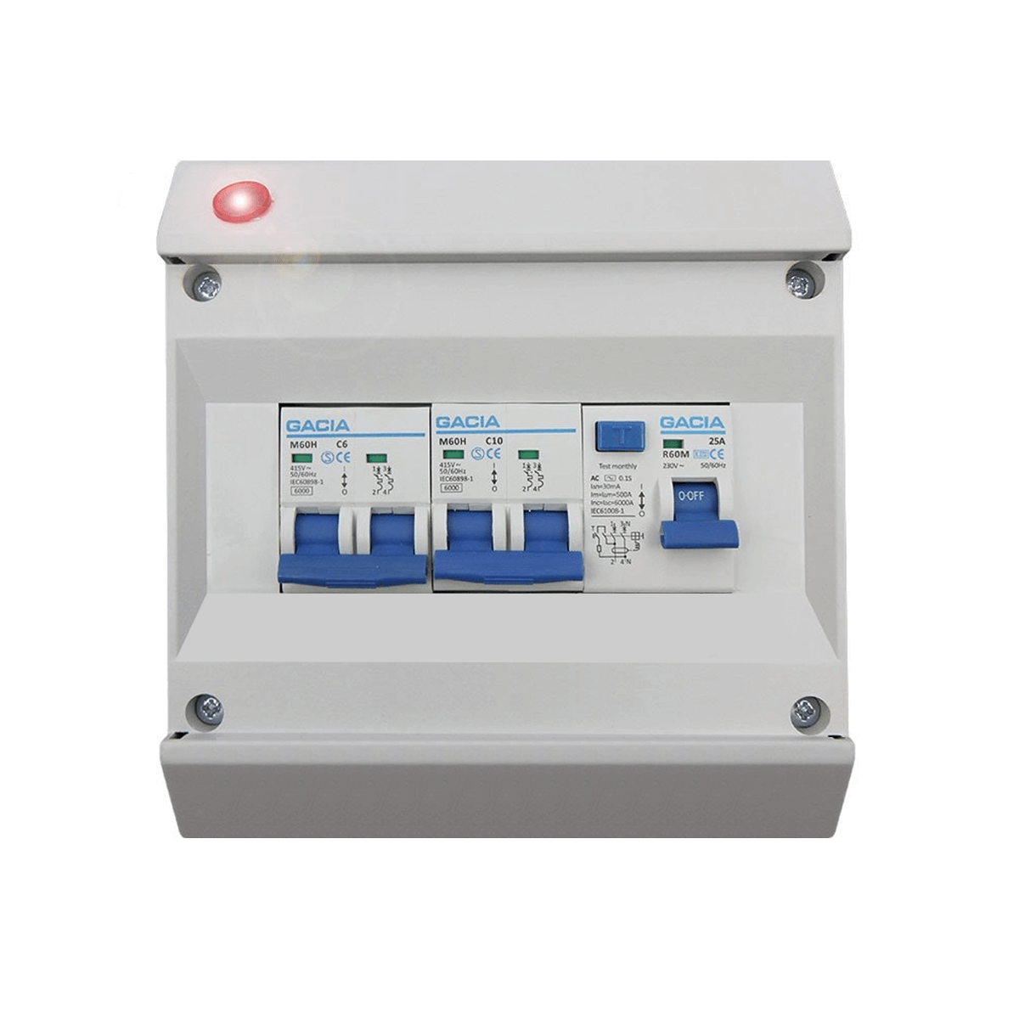
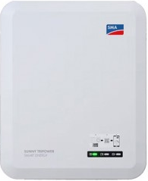
The value of generation
Electricity is used instantaneously so at any time what you have to buy from the grid is defined by: consumption – generation = import
But if you are generating more than you are using at the time, this means you will have export.
consumption
import
export
generation

Slide 3
The value of generation
Why does this matter so much?
Import costs 34p/kWh
Export earns 12p/kWh
So – Generation used is worth around 3x generation exported
consumption
import
export
generation

Slide 4
The value of generation
For a building with limited daytime electricity use this means that the value of generation will mostly be at the lower export price giving poor value
Batteries can help but add extra cost – companies should be able to give a comparison.
consumption
import
export
generation

Slide 5
The value of generation
Because of this, PV is financially viable in two specific cases:
Small scale local systems in buildings with high daytime energy usage - where the majority of generation is used on-site to avoid electricity purchase (import)
Large scale solar farms where all generation is exported at the lower rate but the construction and operation costs benefit from economies of scale
However, in either case, the carbon saving is the same

Slide 6
What this means for Churches
All churches have a lovely south facing roof! But…
In churches with limited daytime energy use, PV may not be financially viable.
Church Halls, Village Halls, Community Centres etc. might be better suited to using PV generation
In addition, there can be difficulties with heritage, roof structures etc.

Slide 7
Why does this matter?
The Church of England doesn’t have funds to pay for PV across all Churches
Therefore we need to raise money to install PV if the Church as a whole is to meet its commitment to achieve net zero carbon
If the PV can offer a (modest) return on the investment, this funding can be raised through community investment rather than simply donations

Slide 8
How to square the circle?
Install PV on another community building that can benefit from the generation
This offers the potential to deliver lower cost energy to a local group
The Church can count this generation towards its net zero goals

Slide 9
The Proposal being explored
The Diocesan Environmental Working Group is exploring the potential for Parishes to come together to install solar on church or community buildings
South facing* unshaded roof
Regular day time electricity use
Willingness to work with the Church

Slide 10
The Proposal being explored
A larger-scale project would simplify planning and open other funding sources.
This would enable parishioners to invest in the scheme for a modest return (rather than relying solely on donations) which is expected to enable much more rapid adoption
Centralising the funding will greatly reduce the administrative costs
It also enables parishioners to participate even if their own community had no suitable building to install PV

Slide 11
Next Steps
If you are considering PV for your church, please let us know so we can include this in our planning
If you have a potential community building in your parish, please also let us know this

