Slide 1
The one life

Slide 2
A humanist approach to life: a summary
Humanists believe the world is a natural place – we should ask questions and look for evidence to help us to understand it (humanists don’t believe in a god)
Humanists believe we should be free to find what makes us happy
Humanists believe we should be kind to other people, animals, and the planet

Slide 3

A humanist approach to living a happy life
The Happy Human is a symbol of humanism
There are many different ways to be happy
Everyone should be free to find what makes them happy

Slide 4

A HUMANIST SYMBOL
What does this symbol look like to you?
What does it make you think of?
When might you stand like that?
Why do you think humanists organisations choose to use this symbol?

Slide 5






THE HAPPY HUMAN

Slide 6
Happiness
What makes you happy?

Slide 7
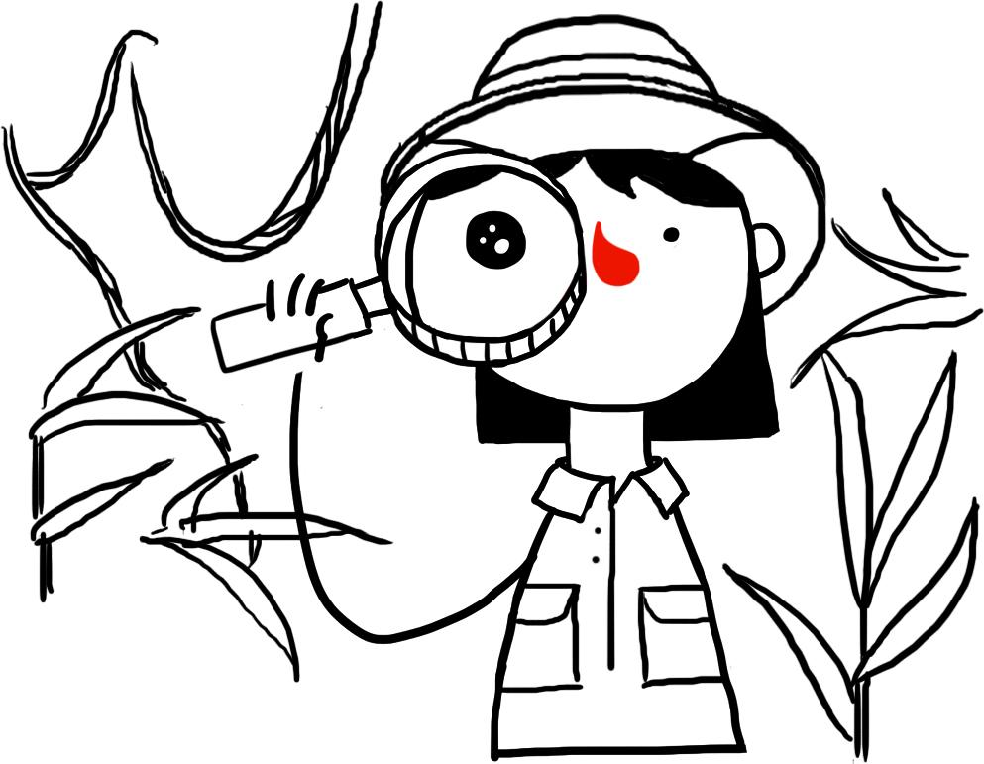
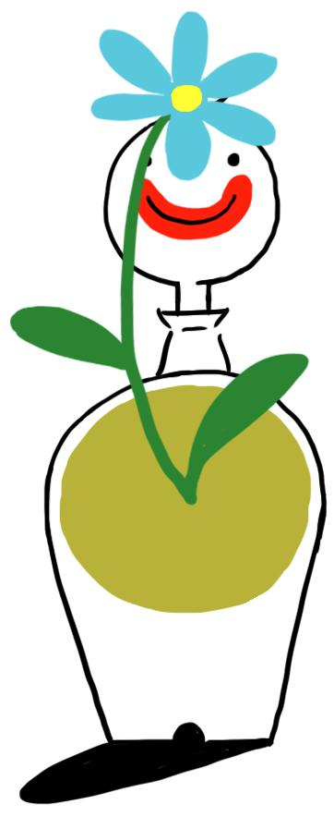



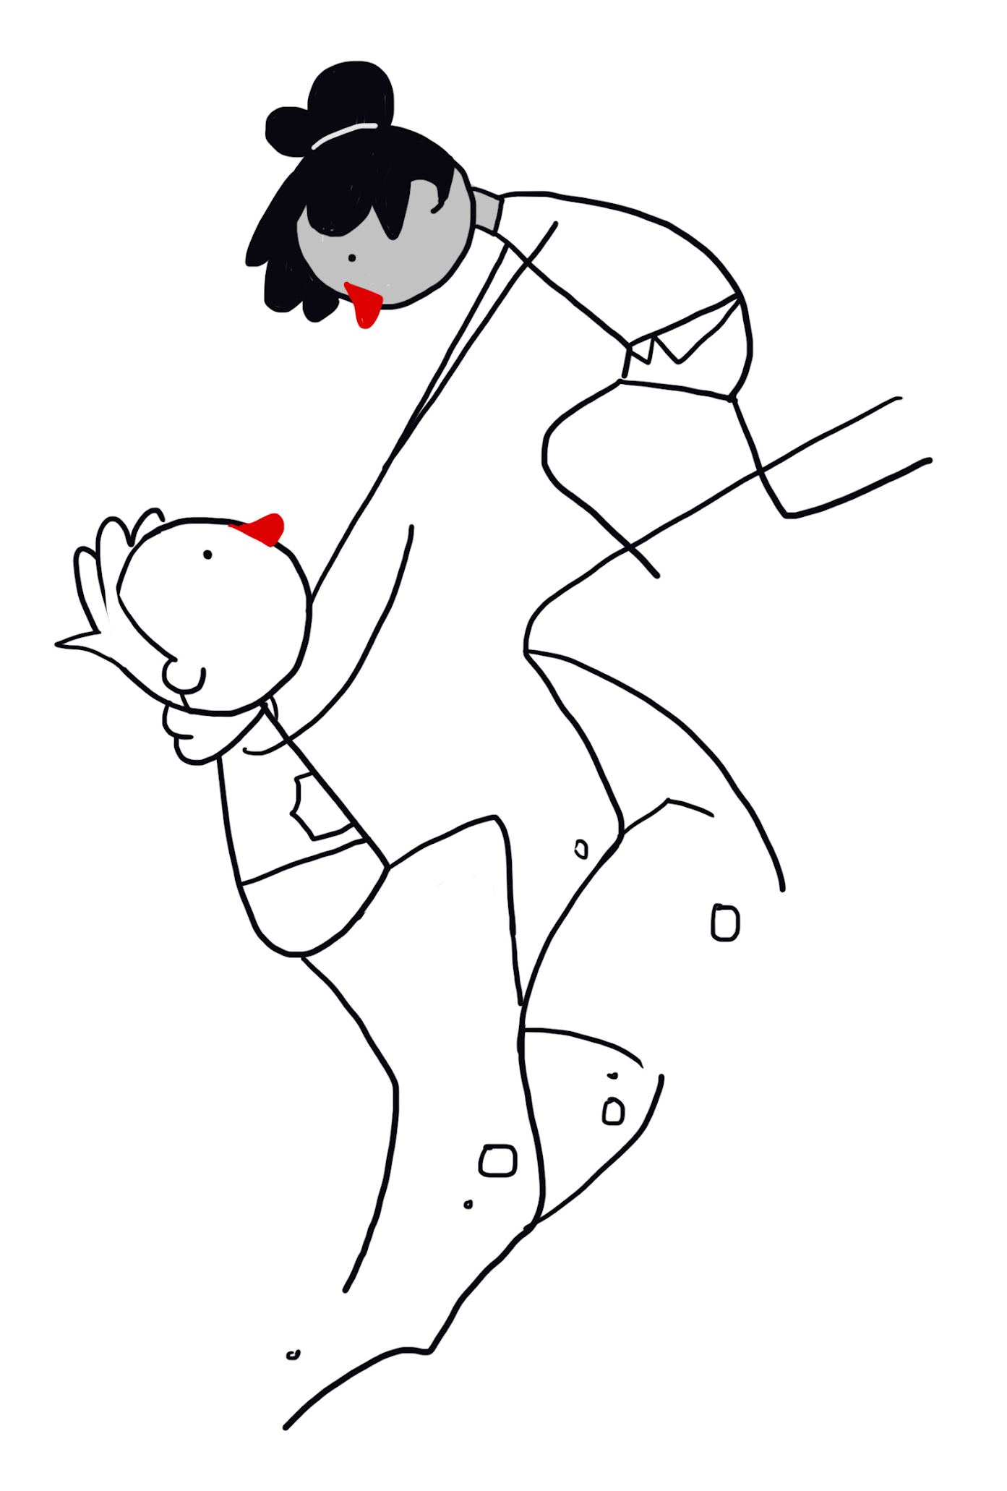

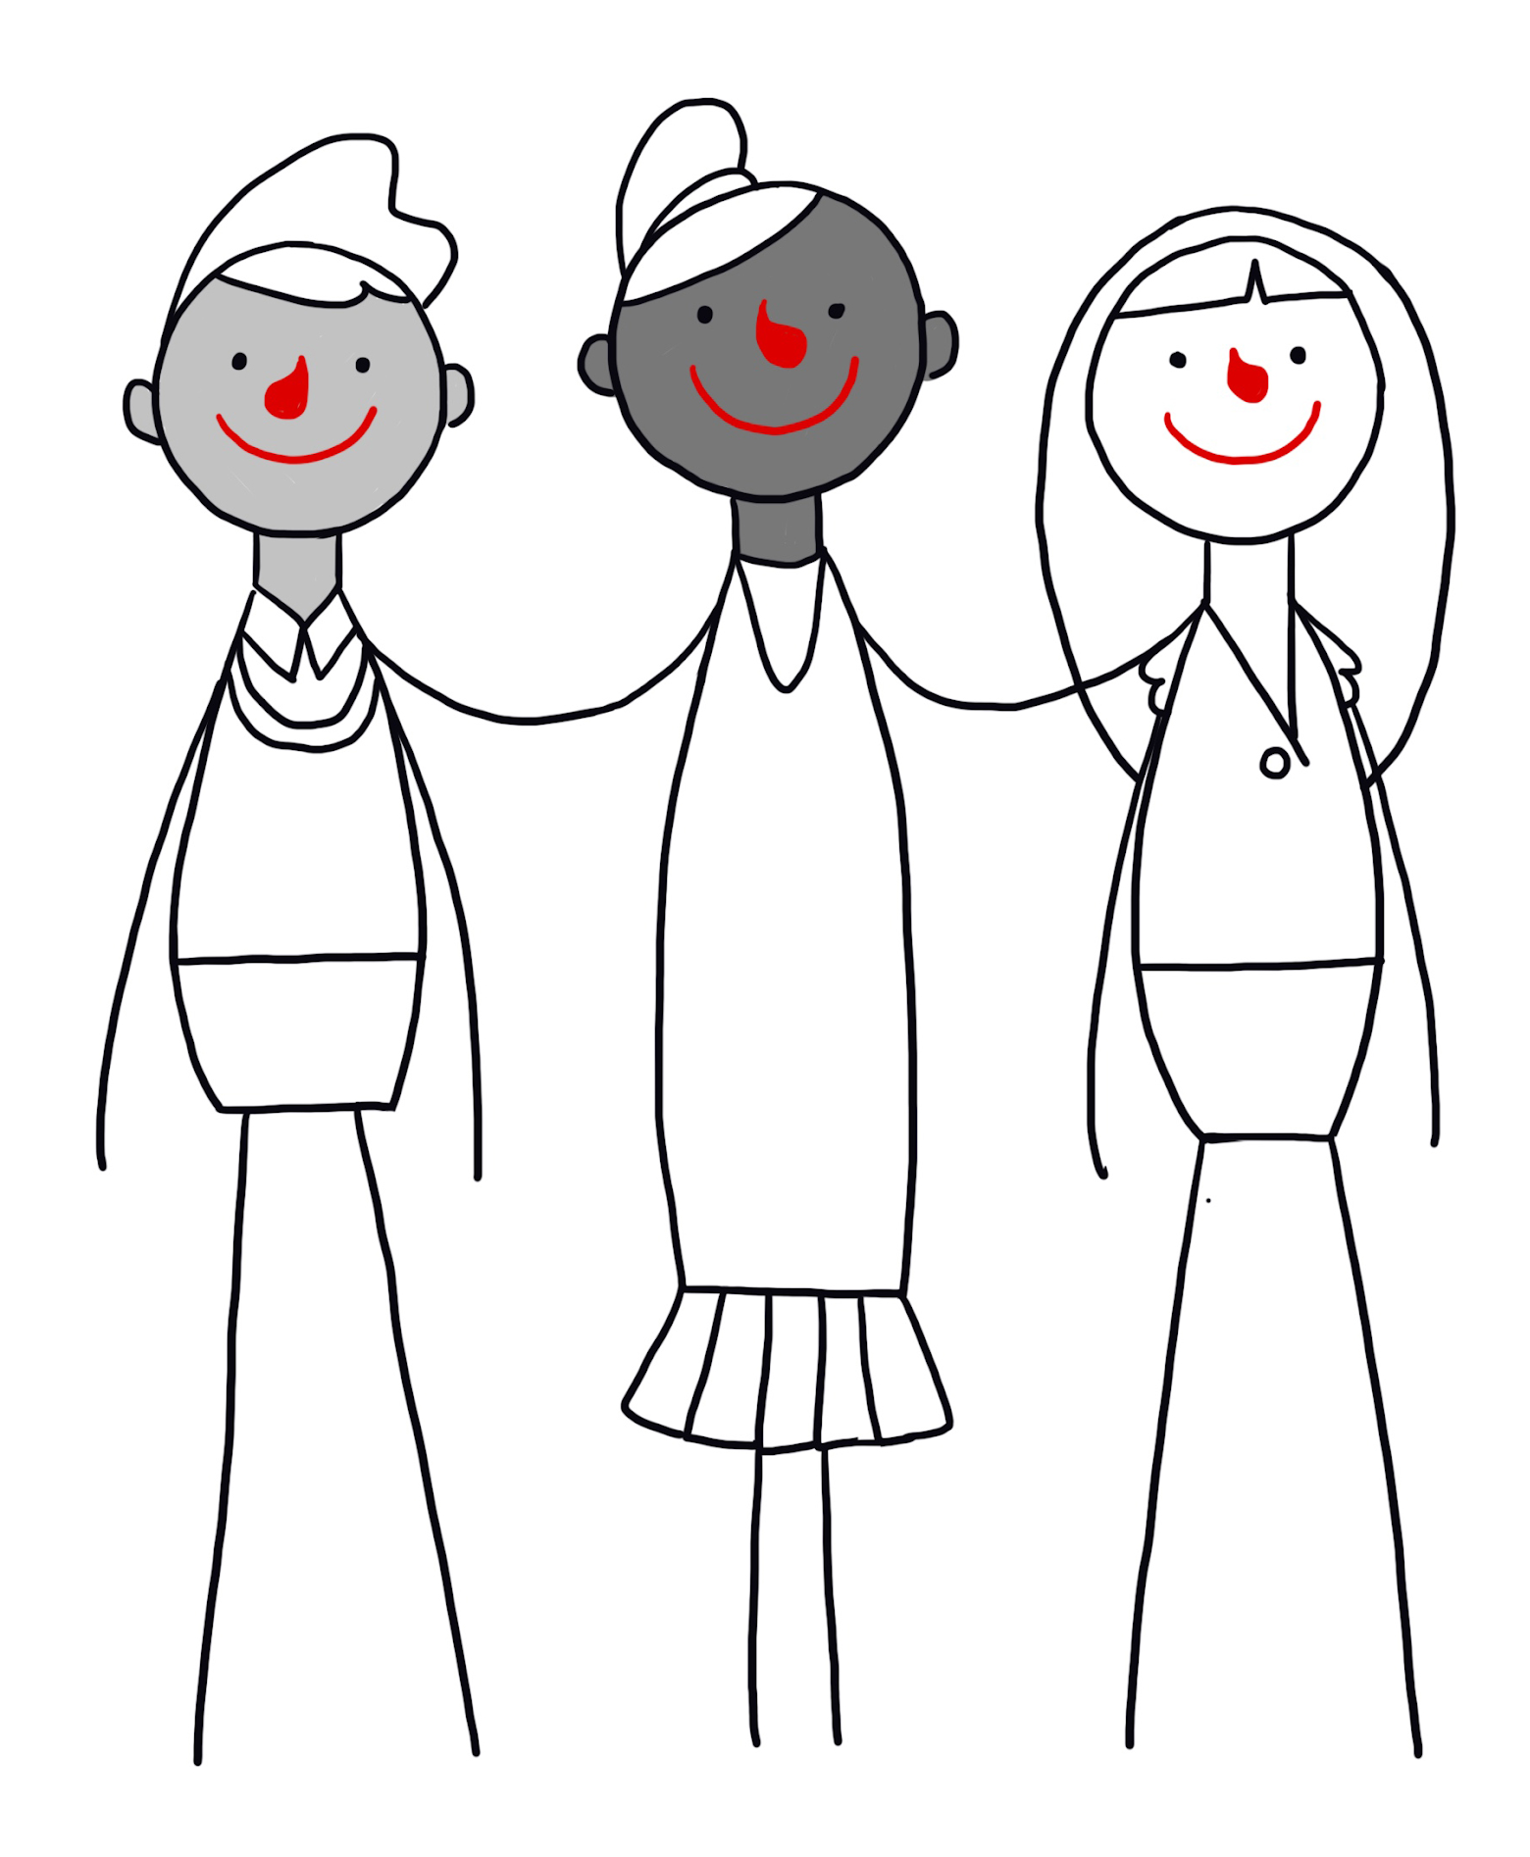
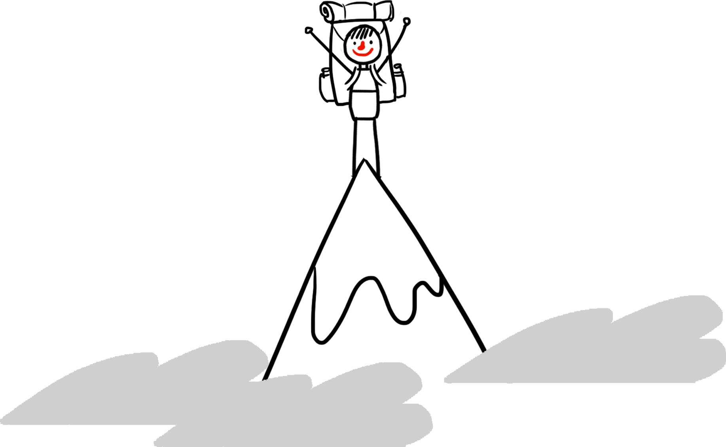

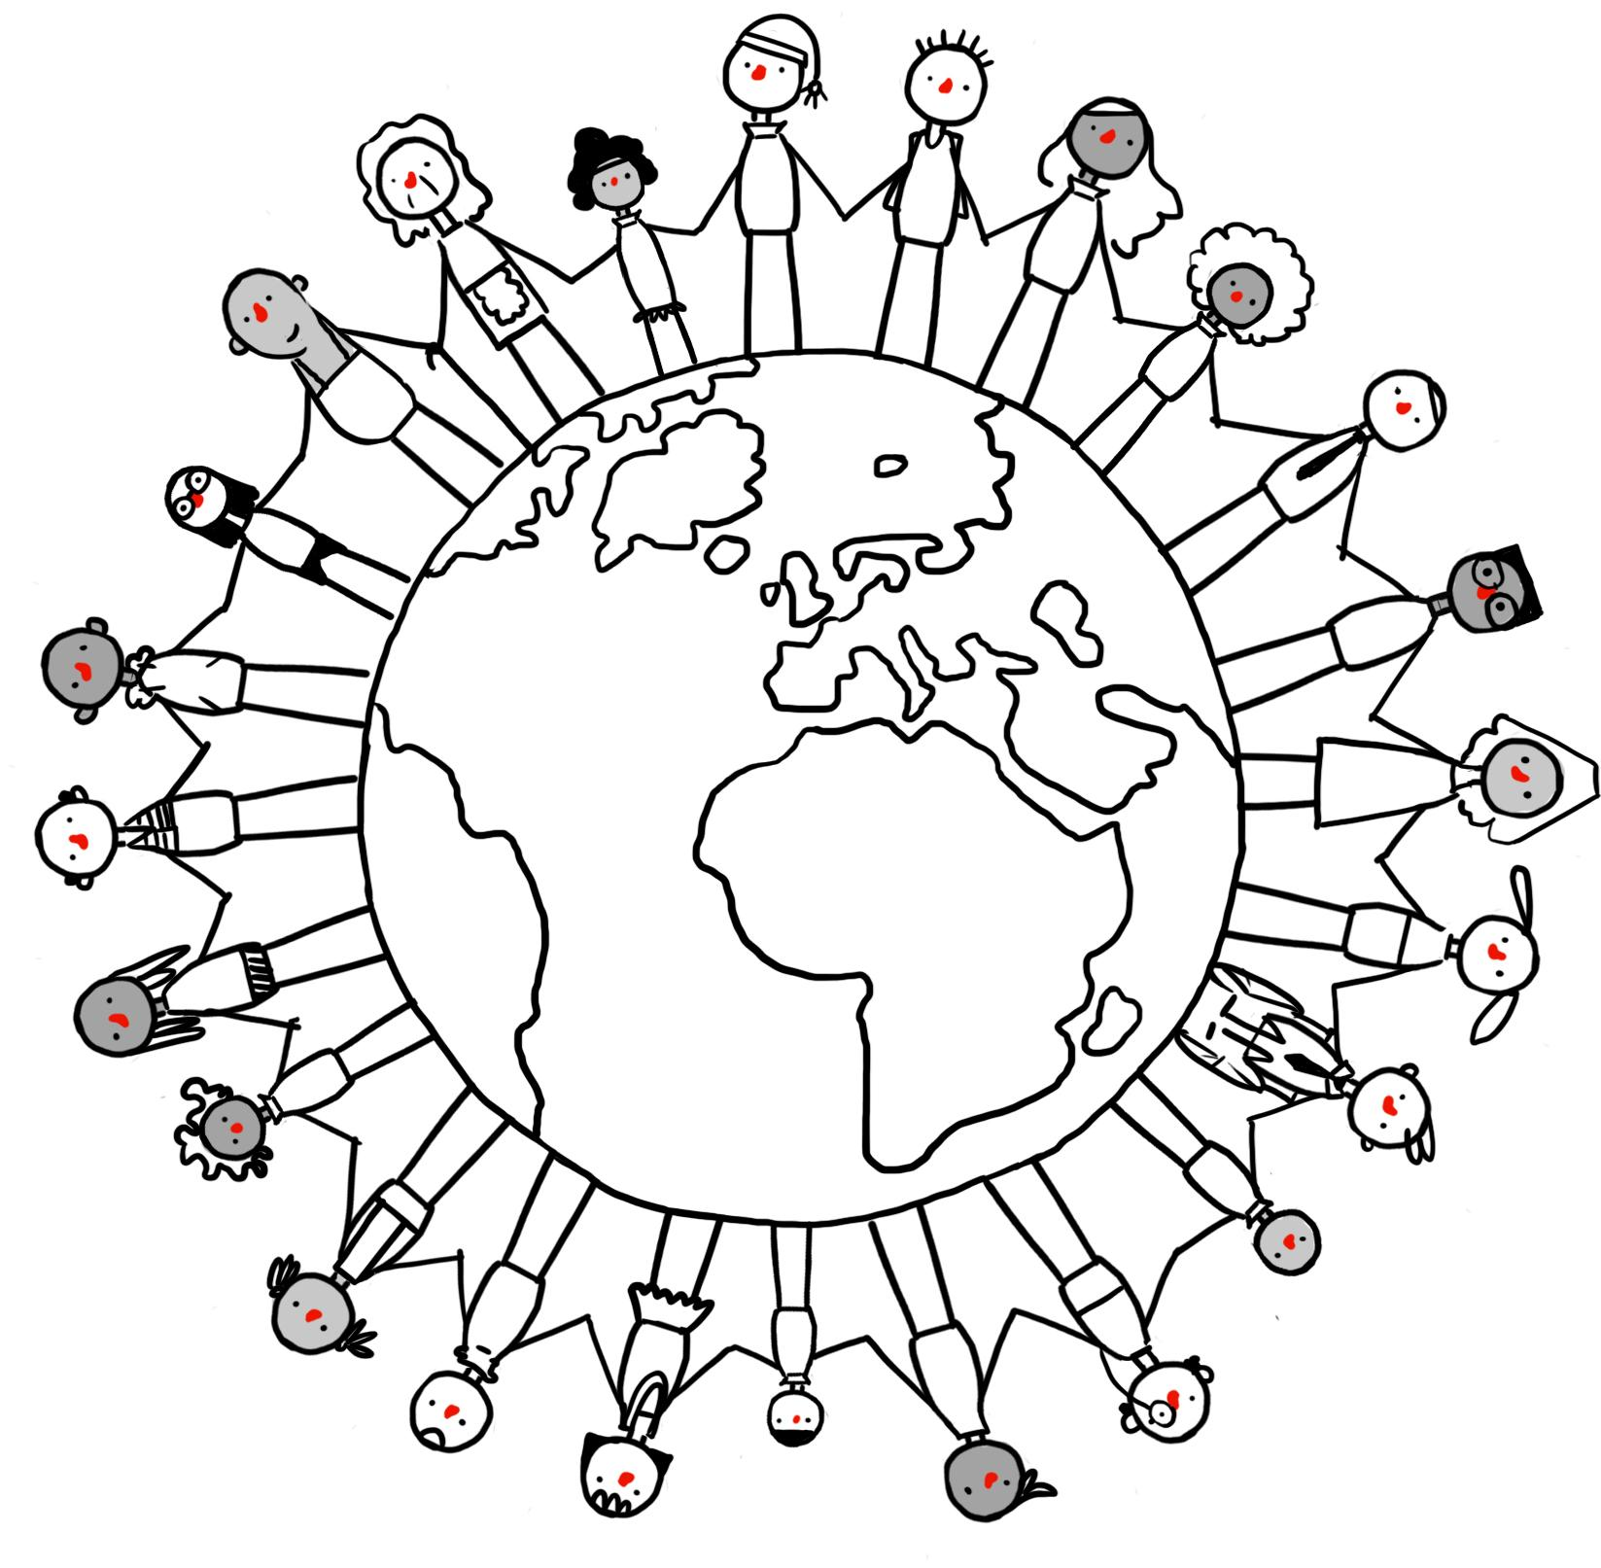
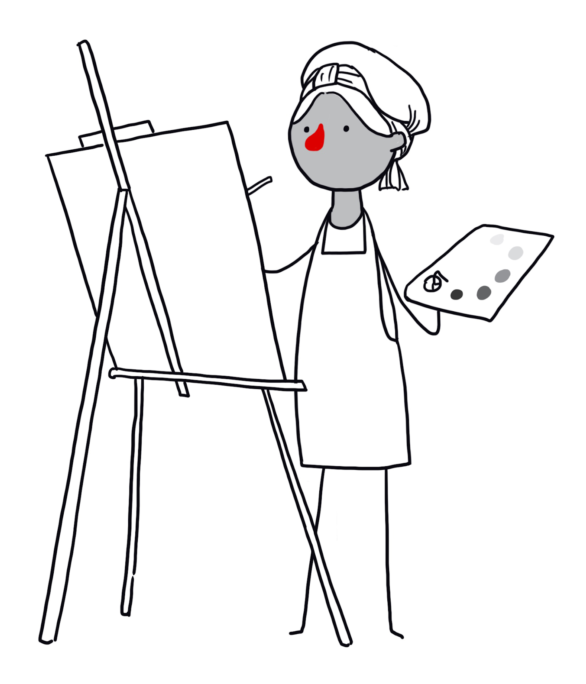
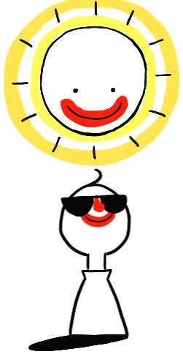
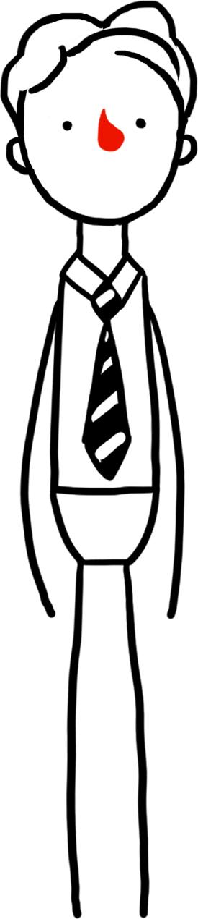
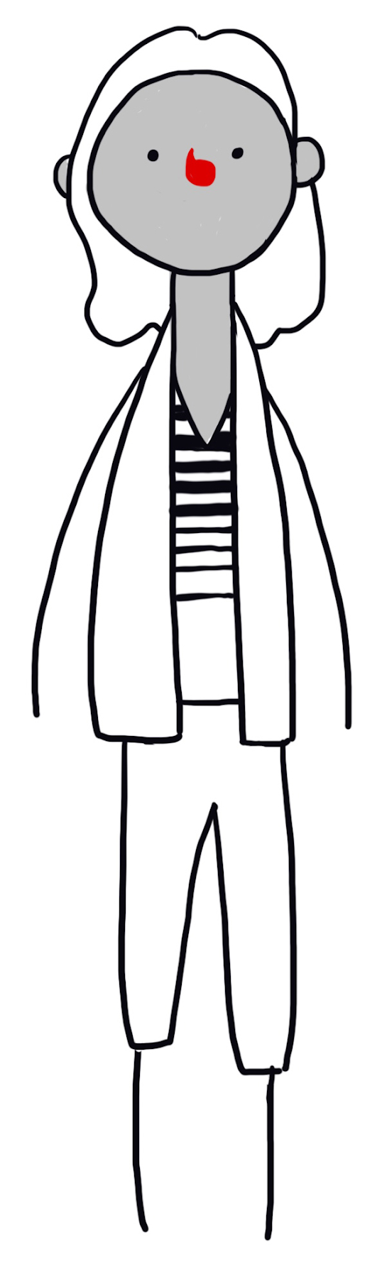
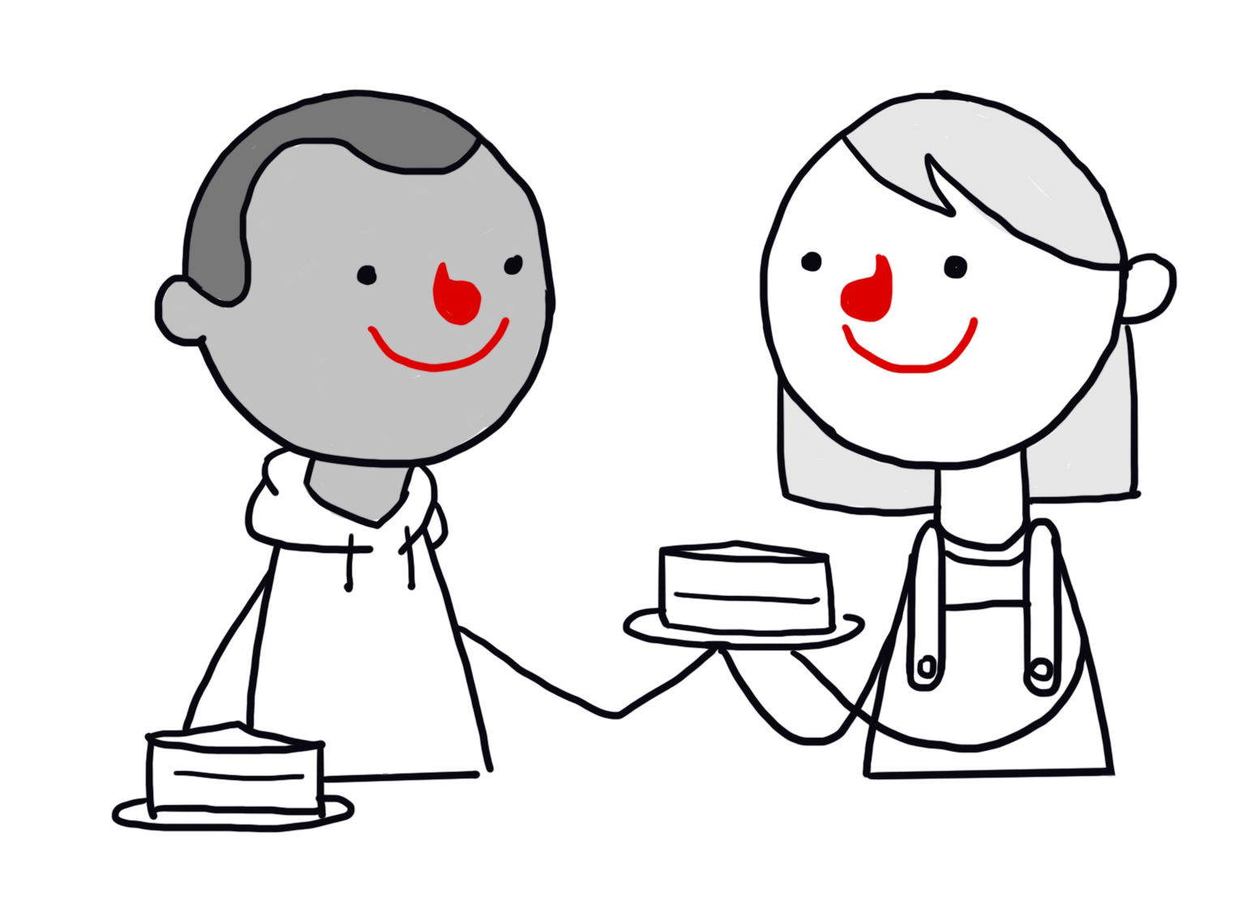


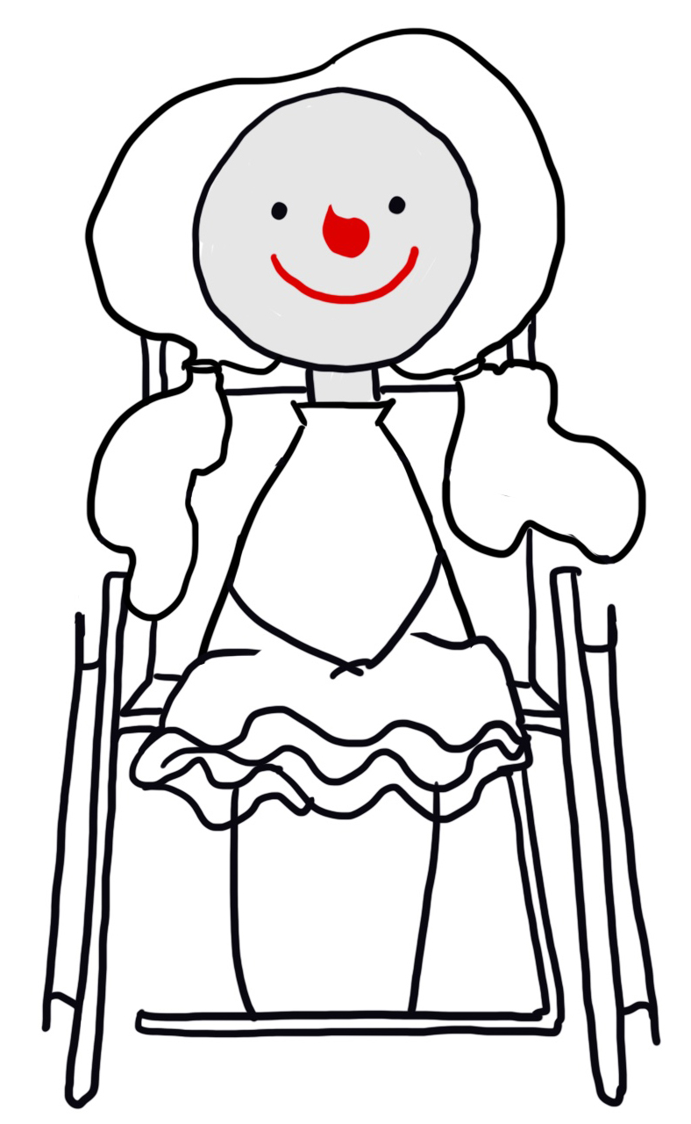
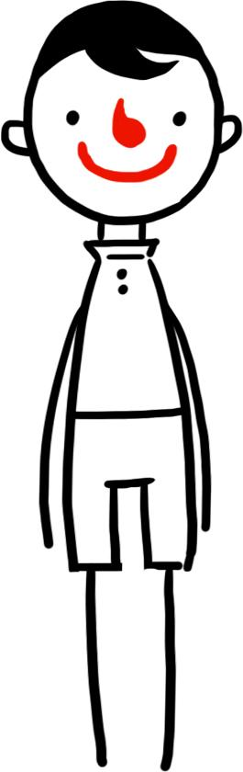
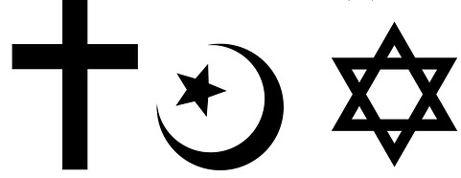
POSSIBLE INGREDIENTS OF HAPPINESS
£

Slide 8
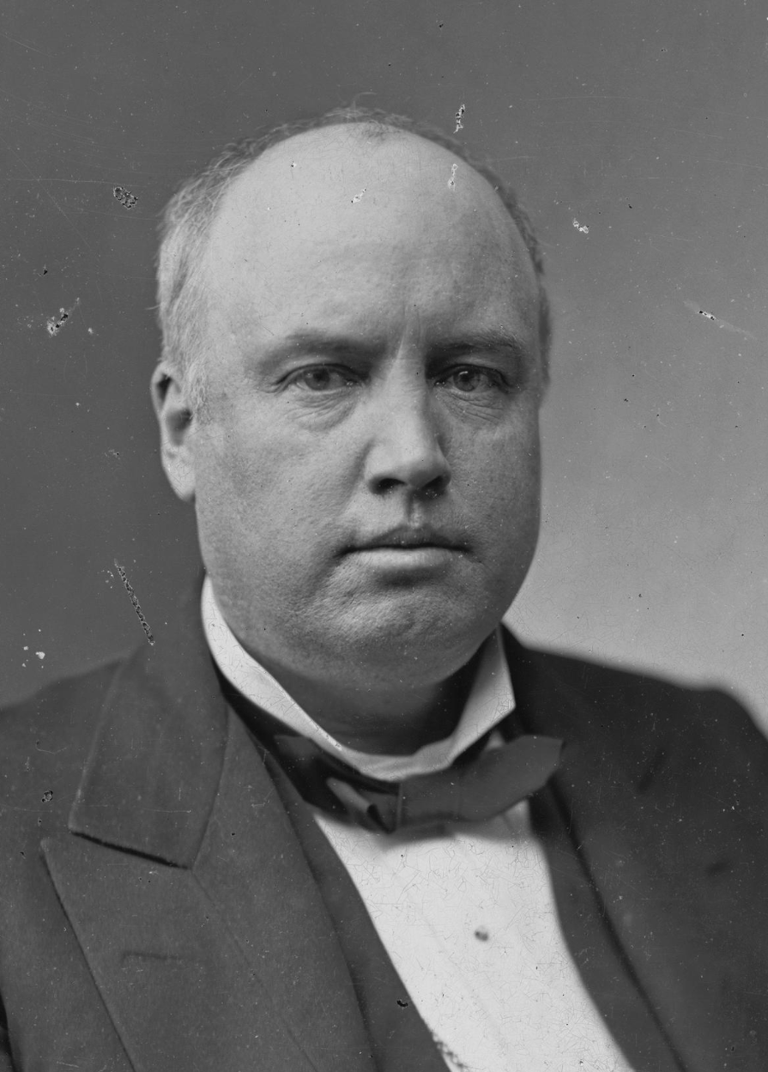
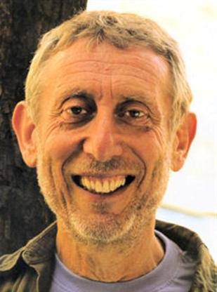
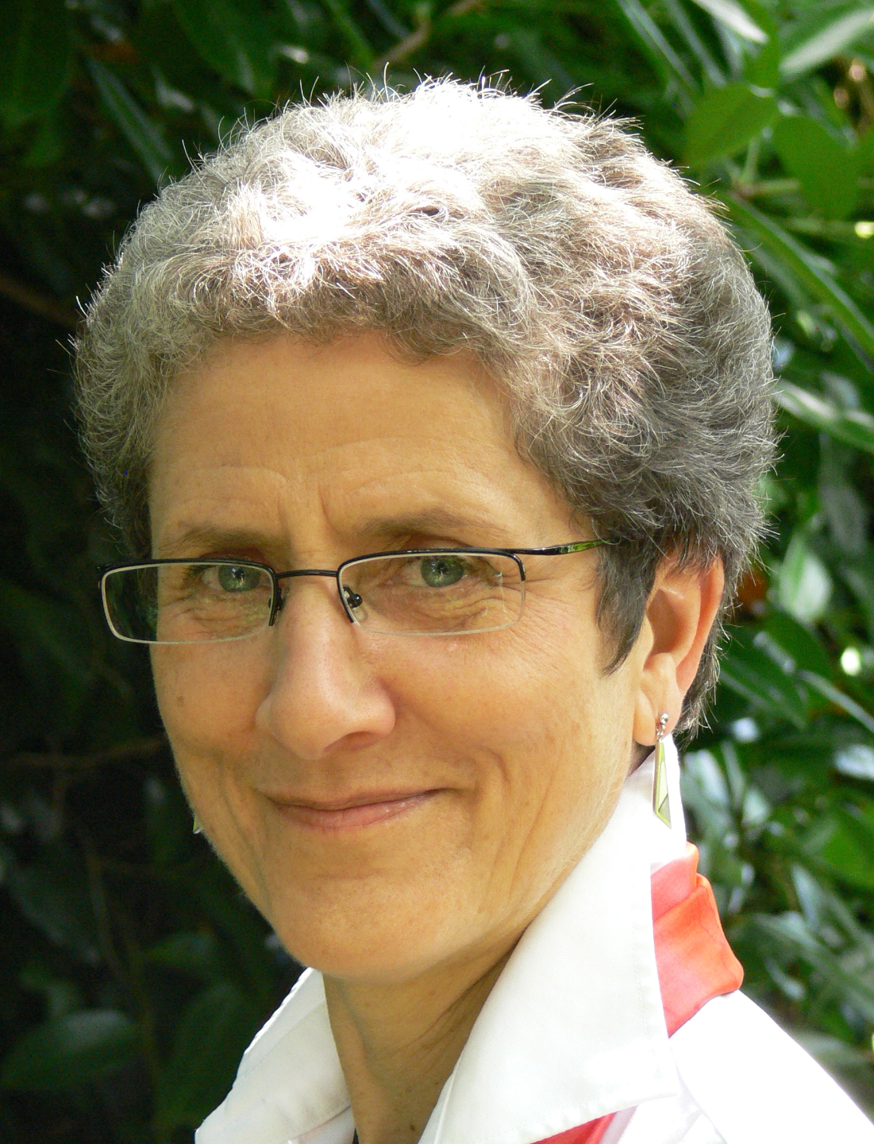
Happiness
‘The place to be happy is here.
The time to be happy is now.
The way to be happy is to make others so.’
Robert Ingersoll (1833 – 1899)
‘It's not enough to be a happy individual; we should also try to think of ways in which others – perhaps everyone – can be happy.’
Michael Rosen and Annemarie Young

Slide 9
Freedom
How much freedom should we have?

Slide 10

Freedom
‘For me, freedom is one of the most important things in life: the freedom to believe what I choose and to live my life however I wish, as long as I don’t cause harm to others.’
Imtiaz Shams, Trustee of Humanists UK

Slide 11


Slide 12
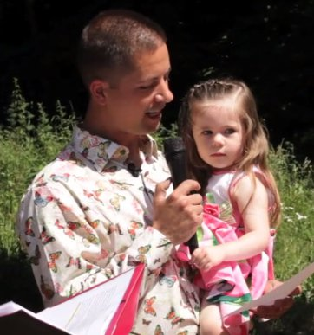
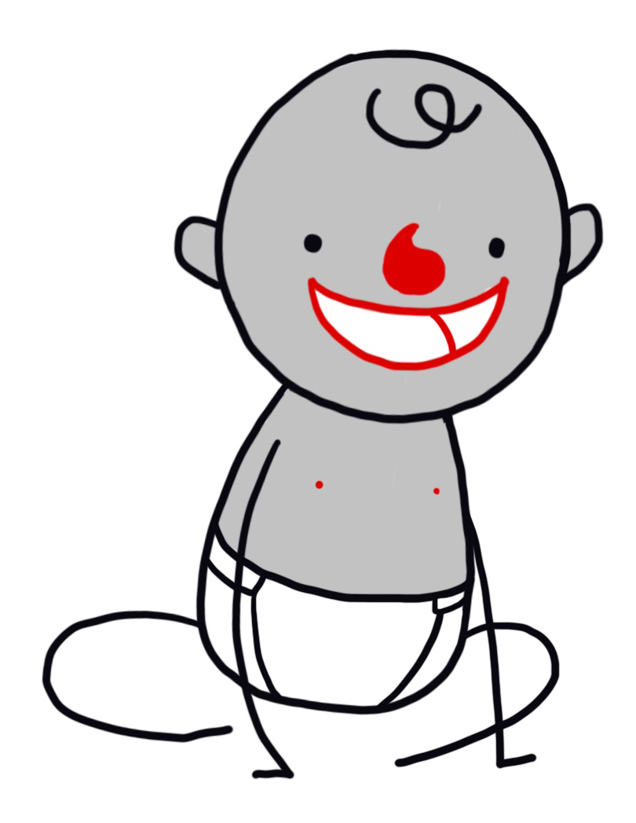
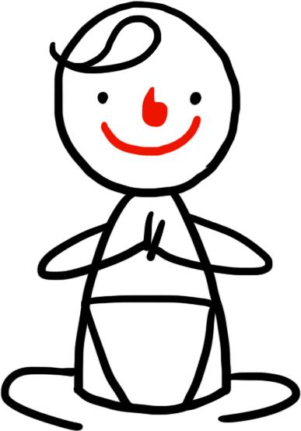
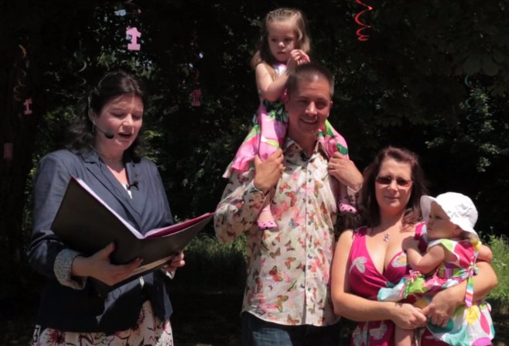
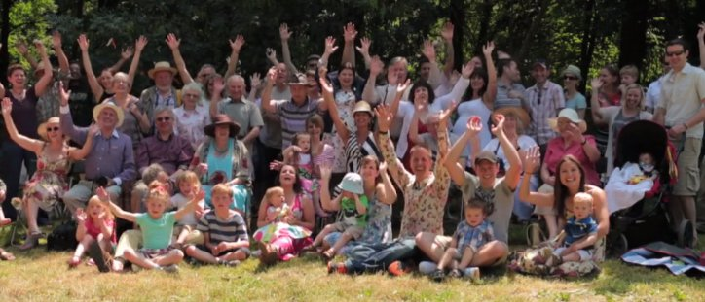
Humanist naming ceremonies
Support
Freedom
Love
Connections
Responsibility

Slide 13

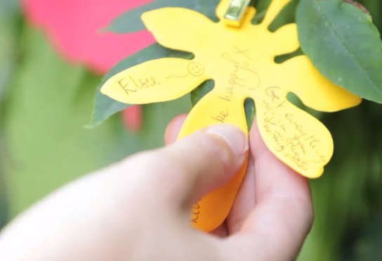
Humanist naming ceremonies

Slide 14

The one life
The Happy Human
Decorate a Happy Human
with the ingredients of happiness
Can you design your own symbol for humanism?

Slide 15
A humanist approach to living a happy life
The Happy Human is a symbol of humanism
There are many different ways to be happy
Everyone should be free to find what makes them happy

