Slide 1
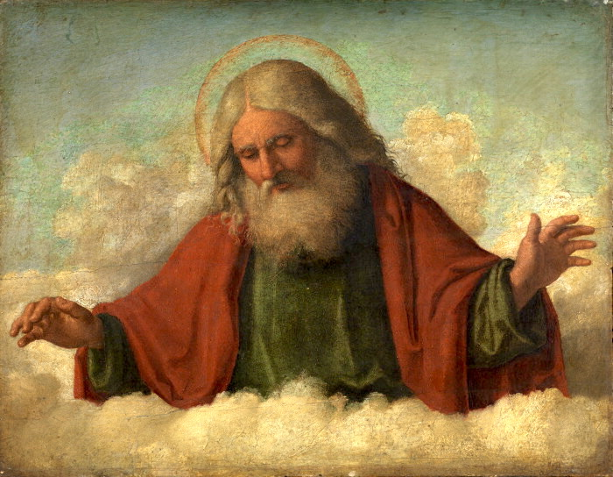
Christian’s believe God to be the creator of all things. That he created the earth and everything in it and when he finished, he looked and said, ‘ and it was good’.

Slide 2
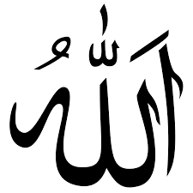
Allah is beyond human understanding and therefore cannot be portrayed in image. Pictures or statues of other human figures are avoided because they could mistakenly be worshipped. This is one of the gravest sins in Islam.

Slide 3
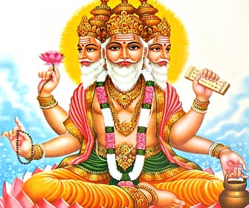
Hindu’s believe Brahma is the creator of the world but there are lots of other lesser Gods who they also worship for different reasons.

Slide 4
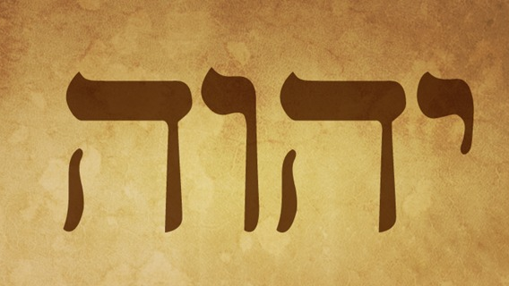
Jews believe YHWH (pronounced Yahweh), the God of Israel, with the creator of the world, who had been known and worshipped from the beginning of time. There are no images of God in Judaism as this would be seen as a major sin.

Slide 5
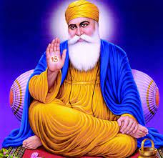
Because God has no form, Sikhs do not have images of God in their place of worship, the gurdwara . Sikhs do have pictures of holy people, eg Guru Nanak, the founder of Sikhism. However, they do not worship the Gurus.

Slide 6
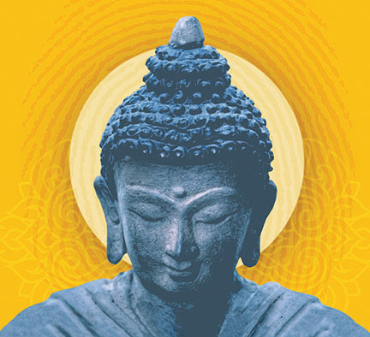
Followers of Buddhism don't acknowledge a supreme god or deity.

Slide 7
Humanists don’t believe in God. The believe in science proving how things happened. They believe that humans make the world a good place by doing good things.

