Slide 1
I am free to be me
Building confident identities in a global society

Slide 2
What do kids need?
A framework for evaluating issues placed in front of them for actions that are right or wrong with a sense of a higher power to whom they are accountable
In the race to avoid the challenges we face in that framework or to soften the impact, children have become more tuned to their desires but not their obligations.

Slide 3
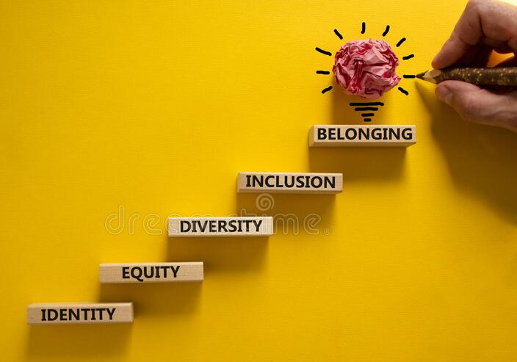
How do we move children towards freedom?
What influence do I have to shape my world?
How will I know I should be there?
What do I need?
Who am I?
Notes:
NOTE: To change images on this slide, select a picture and delete it. Then click the Insert Picture icon in the placeholder to insert your own image.

Slide 4
My Acceptance is not hinged on Your Tolerance. Beyond Acceptance is Respect
Notes:
NOTE: To change images on this slide, select a picture and delete it. Then click the Insert Picture icon in the placeholder to insert your own image.

Slide 5
How adults challenge freedom of identity
Overprotection
The world is more challenging – learn to be antifragile
Projection
The world is not like we remember – learn to accept evolving experiences
Edited experience
Pretending children are unaware – learn to discuss and frame reality

Slide 6
Control
Assumed wisdom of seniority as best option – learn from our children
Personal identity
Children are emblems of parental success
Change avoidance
Engaging with difference is challenging – learn to know and accept difference

Slide 7
So how do we build positive identity

Slide 8
My Skin, Your Skin written by Laura Henry-Allain illustrated by Onyinye Iwu
Notes:
NOTE: To change images on this slide, select a picture and delete it. Then click the Insert Picture icon in the placeholder to insert your own image.

Slide 9
Who am I now?
Image Credit B. Todd

Slide 10
