Slide 1
Challenges facing children in 2021
From The Good Childhood Report
Mark Russell
Chief Executive
@markrusselluk
Date

Slide 2

Our work

Slide 3
The challenge before is huge
4.3 million children are growing up in poverty and this figure is expected to rise
Our research shows the most vulnerable children and young people are living with seven problems in their lives, which could include poverty, neglect, abuse, youth violence or mental health issues
The number of children between 5-19 with a mental health condition is rising and affects an average of six children in a class of 32 but only a tiny percentage of those are getting the help they need
80% of parents are worried their child may be groomed online but only 20% have any idea of what the signs are or where they can get help

Slide 4
Our Key areas of focus
Emotional Health and Well-being
Fighting child poverty
Reducing adolescent risk
Each earthed in front line work
Each focussed on co-design with young people
Each focused on systems change
Notes:
WHO – Our Goal commits to overturning the damaging decline in children’s well-being, and we want all children’s well-being to improve. But we are also committed to working with the most disadvantaged young people, and cannot fail them at the expense of achieving the Goal. For this reason, we will focus on the most disadvantaged young people, and believe if we do this then well-being will improve for all young people
LEVEL OF CHANGE – We are committed to changing the lives of every individual we work with. But we cannot possibly work with every disadvantaged child. For this reason, whenever there is an opportunity to change a system that will improve well-being for multiple young people this must be our preference, as we will be making a greater impact
ROLE OF YOUNG PEOPLE – We have committed to measuring subjective well-being. This means listening to what young people say. For this to be more than tokenesque, we have an obligation to take on board what is being said, and consider how our processes, systems and ways of working could be improved to support young people based on their own feedback
PARTNERSHIP – We are committed to making the greatest impact we can on the lives of young people. To do so, we want to work in partnership wherever possible – drawing on skills and expertise across the sector, and amplifying our impact with and through others
SHARED STRATEGY – We are committed to achieving our Goal collectively. We are one organisation, with shared goals, and we know we are stronger when we work together and support each other to achieve our aims

Slide 5
We work directly to support the most vulnerable
young people
By providing support for victims of criminal and sexual exploitation and those that go missing from home.
By supporting and advocating for unaccompanied asylum-seekers and victims of trafficking.
By providing life-changing therapy and counselling for teenagers and young adults struggling with mental and emotional health issues.
By leading the only annual survey of young people’s well-being across England and Wales.
By supporting teenagers at risk of harm through domestic violence, or parental and teenage substance misuse.

Slide 6
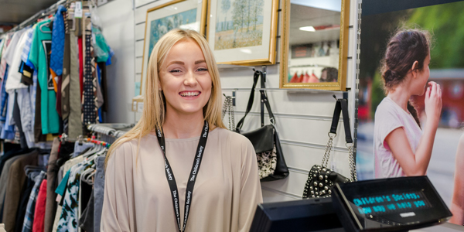
Our impact
Our work is child centric, holistic, and responsive to young people. We confront and challenge hard truths. We will build a strong movement of partners and supporters who share our ambition
This year we worked with 40,000 young people through direct practice and youth engagement
We reached 350,000 young people through systems change work
We worked with 13,363 professionals
87% of young people said they were happy with our services and 89% felt they could trust their worker
Delivered 8 million policy impacts for young people through our campaigning and policy
9307 volunteers gave half a million volunteering hours
We have 132,000 supporters

Slide 7
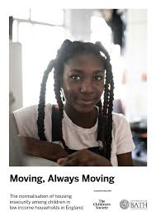

How TCS makes an impact to
Change systems…
We secured a change in benefits for care leavers, and £500m for Local Welfare Assistance Schemes
We worked with partners to get children recognised as victims in the DA Bill
Our Disrupting Exploitation programme has been working with the Met Police an trained over 1000 custody officers in London how to spot signs of criminal exploitation of children
Our #LookCloser campaign reached over 20m people
We changed the law on school uniform

Slide 8
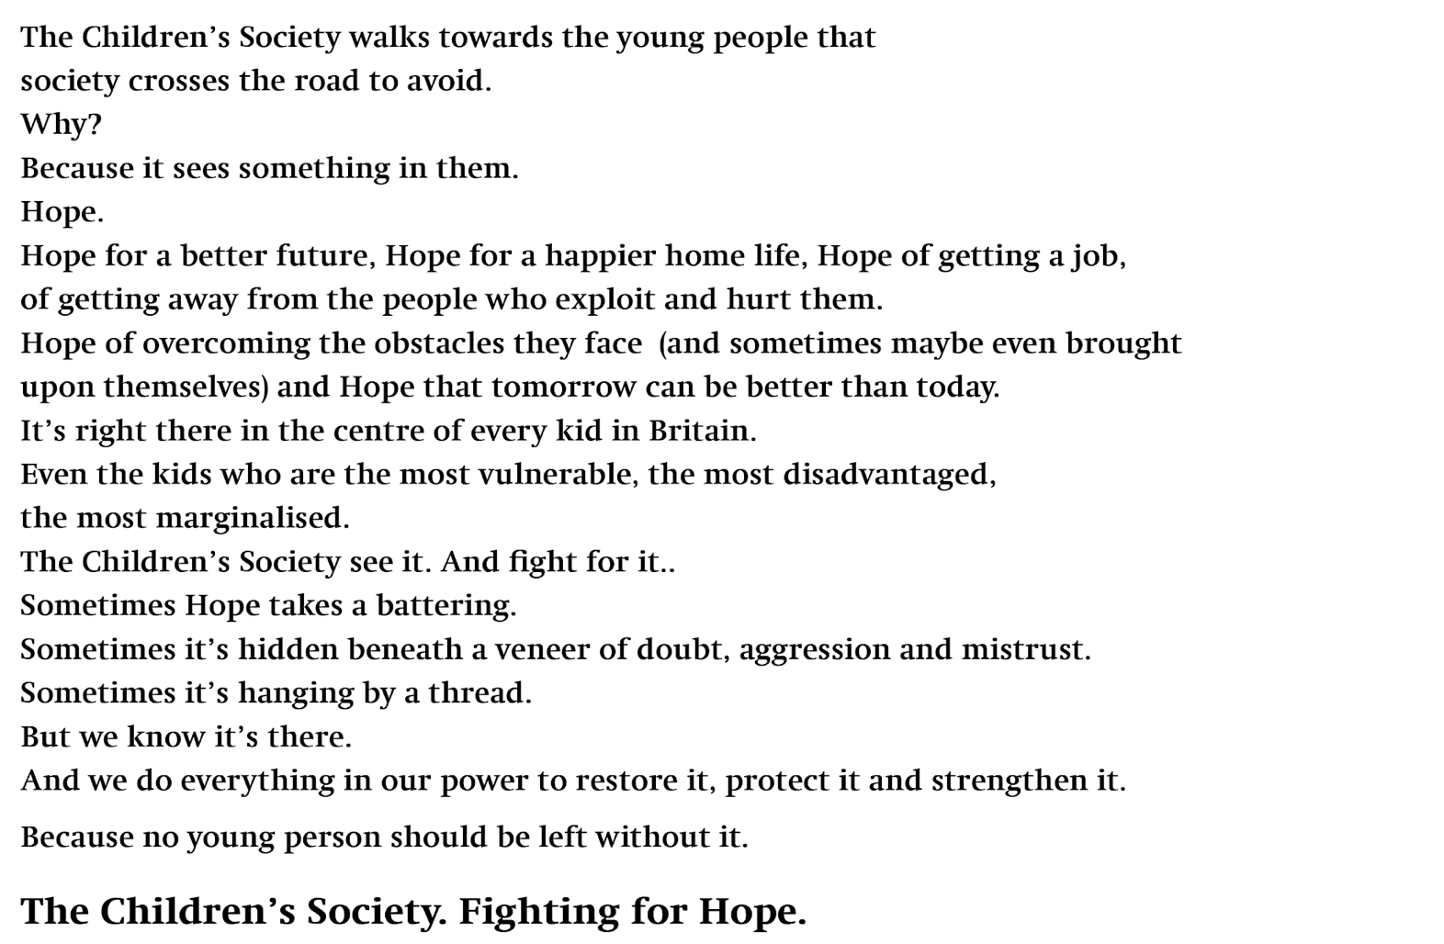

Slide 9
Good
Childhood
Report

Slide 10
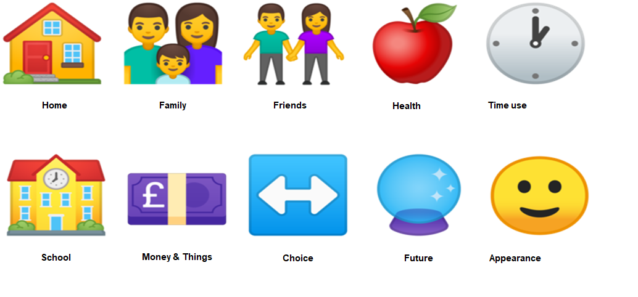
Our understanding of well-being
Notes:
Why we are best placed

Slide 11
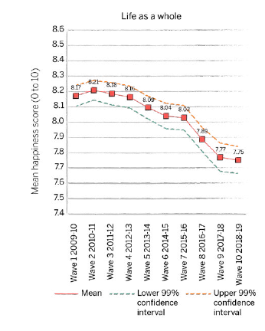


Trends in children’s well-being 2018-19
(from Understanding Society)
Figure 1: Trends in children’s (age 10 to 15) happiness with life as a whole, UK, 2009-10 to 2018-19
Comparisons between 2009-10 and 2018-19 show:
Happiness with life as a whole, friends, appearance and school significantly lower than in 2009-10.
No significant change in happiness with family or schoolwork compared with 2009-10.
Appearance: Boys significantly happier than girls across survey years (although boys mean score has reduced).
Schoolwork: Girls significantly happier than boys across most waves.

Slide 12
Comparing outcomes at age 17 for children with differing levels of subjective well-being in earlier adolescence
Why important?
Allows us to look at well-being and outcomes for same children
Opportunity to look at children at transitional age

Slide 13
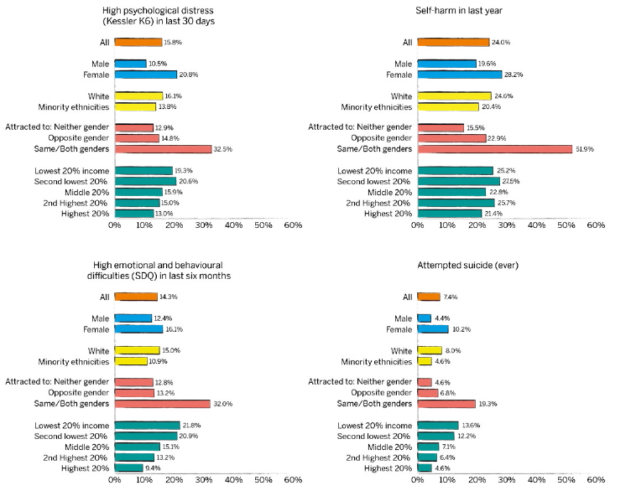
Variations in symptoms of mental ill-health at age 17, by children’s characteristics at age 14

Slide 14
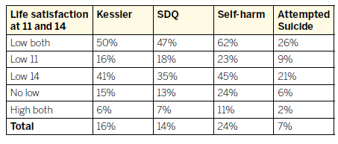
Proportion of young people with poor outcomes at age 17, according to life satisfaction at age 11 and 14
Table 1: Proportion of young people with poor outcomes at age 17 compared to their life satisfaction score at age 11 and 14 (controlling for other characteristics)

Slide 15
Good Childhood Report 2020
Last year’s report showed that children’s well-being in the UK is the lowest in Europe.
Two reasons stand out why children in the UK are struggling much more than their counterparts in Europe
The UK has the highest levels of child poverty
UK children have a significantly higher fear of failure

Slide 16
Children’s experiences of Covid-19: One year on
How are children (and their parents) faring one year on from Life on Hold?
How do children feel about the future?

Slide 17
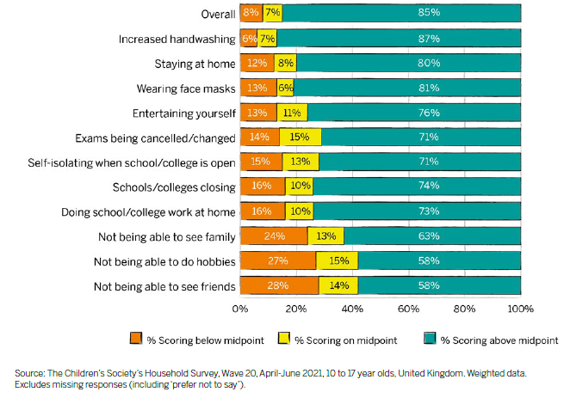
Children’s reflections: How well coped with pandemic
Figure 6: Extent to which children (aged 10 to 17) think they have coped with Coronavirus changes

Slide 18
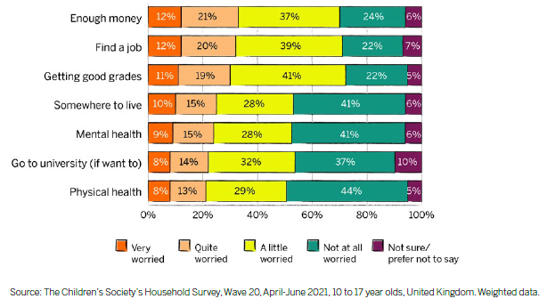
Looking to the future: worries in own life
Figure 7: Extent of children’s worries about their own future
As in 2019, we asked children how much they worried about seven different aspects of their own future.
Having enough money, being able to find a job and getting good grades were the aspects of life that more children said they were worried (very/quite) about.
Children who had coped less well overall with the pandemic expressed greater concerns about all aspects of their own life than other children, with mental health featuring more highly.

Slide 19
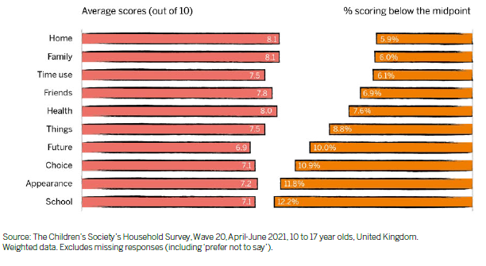
Children’s well-being in 2021
(from TCS household survey)
In The Children Society’s annual household survey 2021, GCI scores more consistent with previous years (than in 2020):
12% of children scored below midpoint on multi-item measure of overall life satisfaction.
Children on average most happy with their home, their family and their health.
More score below the midpoint (suggesting they are unhappy) for school than any other aspect of life.
Figure 3: Mean scores (out of 10) and proportion of children (aged 10 to 17) scoring below the midpoint on Good Childhood Index

Slide 20
Conclusions and Impact

Slide 21
Conclusions
Clear priorities for improvement: friends, appearance and school.
Fortunately most children/parents seem to have coped to some extent with the pandemic. A small proportion in both groups have been identified who have not coped well and might benefit from support.
Children with low life satisfaction scores at age 14 are more likely to report poor mental health outcomes at age 17.
There is potential value in regularly monitoring children’s well-being in early adolescence to identify those who may need extra support. This could have long-term benefits.
In spite of the challenges of the last 18 months, seven in ten children are optimistic about the future. There is still room for improvement and policymakers and practitioners must take seriously children’s concerns – about themselves and wider society.

Slide 22
Policy recommendations
We need to measure children’s well-being as we do for adults
We need to invest in early intervention help for children and young people. This is why The Children’s Society backs the #FundTheHubs campaign
We need a bold and ambitious plan for children and young people. This needs to tackle child poverty head on. Our Government need a vision of Good Childhood so all our children can thrive not just survive.

Slide 23
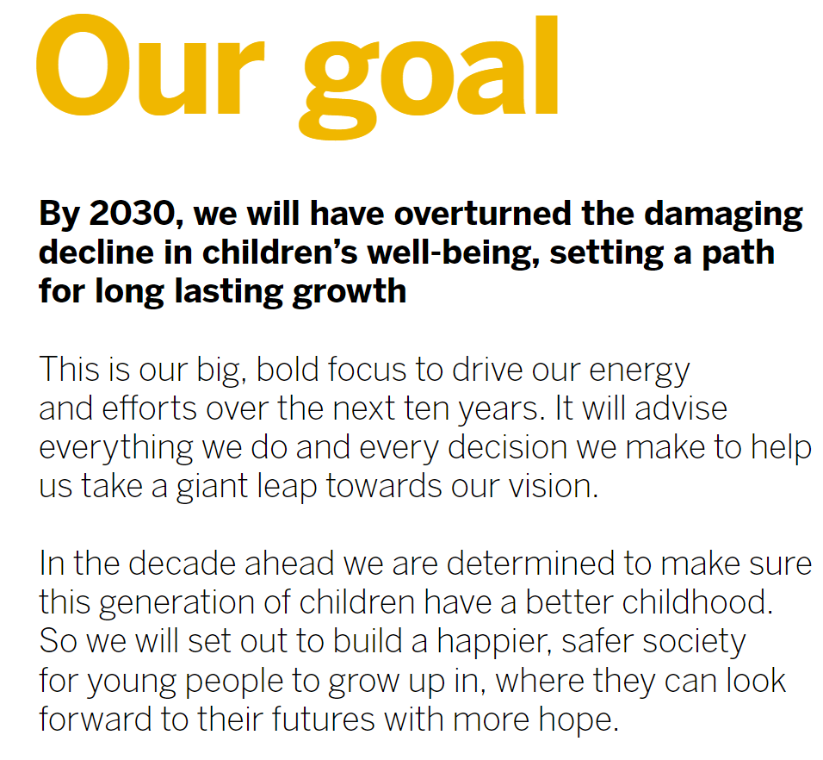
Notes:
In June, we finalised the wording of our new Vision and Goal, and fully integrated it into our brand
Almost everyone we asked said they identified with our existing corporate values, and felt these still held good. So we haven’t changed them. They are that we are Brave, Ambitious, Trusted, Supportive
Our challenge now is to translate our goal into a clear and compelling strategy that will allow us to ‘overturn the damaging decline in children’s wellbeing, setting a path for long lasting growth’
The strategy, our brand, and our culture are the three principal pillars that make up Destination 2030, which will enable us to achieve our goal

Slide 24


Slide 25
Thank you!
If you have any questions or would like to know more about the Good Childhood research programme, contact a member of the
mental health and well-being policy and research team
Wellbeing@childrenssociety.org.uk

