Slide 1
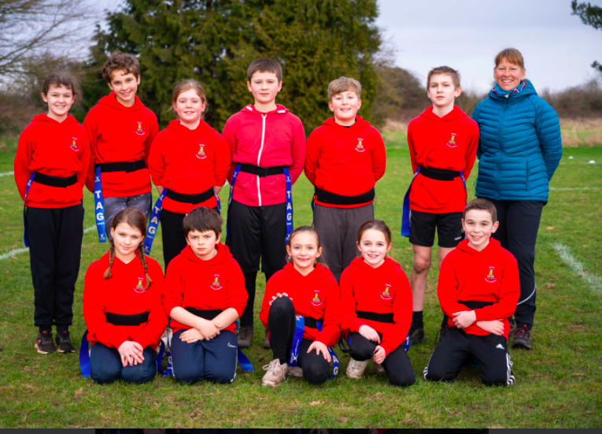
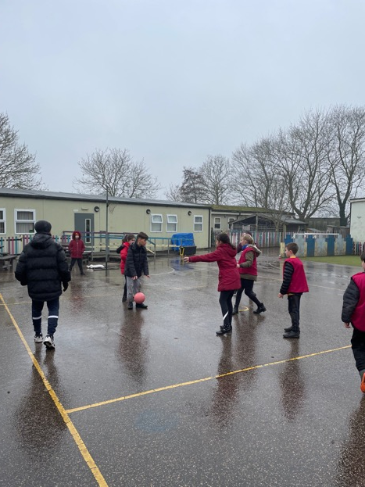
PE and Sport at school JUST DO IT!

Slide 2
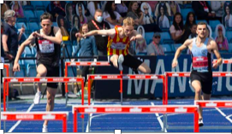
My Background

Slide 3
Becoming a head after being a Teacher and Pe lead
Ready, Respectful, Safe
Together being the best that we can be in mind, body and spirit!

Slide 4
Ofsted highlights the importance of PE and school sport
Our reports show that children’s physical fitness has suffered from lockdown. School leaders told us that children came back less active and less fit. This highlights the importance of physical education and school sport.
Commenting on the wider value of school sport, she added:
If we look back, school sport was once about finding a new talent, developing teamwork and even building moral fibre, as much as about physical fitness. Now it’s also one of the ways schools contribute to countering childhood obesity – alongside the school canteen, which we expect to serve up healthy, nutritious and affordable meals.

Slide 5
A “high-quality” PE curriculum goes beyond normal lesson time and is inclusive of all pupils, Ofsted has said.
1. Build a ‘strong foundation’ of fundamental movement skills(FMS) three skill sets: locomotor skills (like running), stability skills (like balancing) and manipulation skills (like catching)
2. Make sure pupils’ movement is ‘context-related’
3. All pupils should feel included
4. Pupils ‘participate beyond their PE lessons’
5. Feedback nurtures belief pupils can ‘know more and do more’
6. Allow pupils to ‘revisit’ important knowledge

Slide 7
What the data tells us
13% of 4-5 year olds from deprived areas are obese
5% of 4-5 year olds from least deprived areas are obese
26% of 10-11 year olds from deprived areas are obese
12% of 10-11 year olds from the least deprived areas are obese

Slide 8
What are Health Inequalities?
“…preventable, unfair and unjust differences in health status between groups, populations or individuals that arise from the unequal distribution of social, environmental and economic conditions within societies, which determine the risk of people getting ill, their ability to prevent sickness, or opportunities to take action and access treatment when ill health occurs.”
https://www.england.nhs.uk/about/equality/equality-hub/resources/

Slide 9
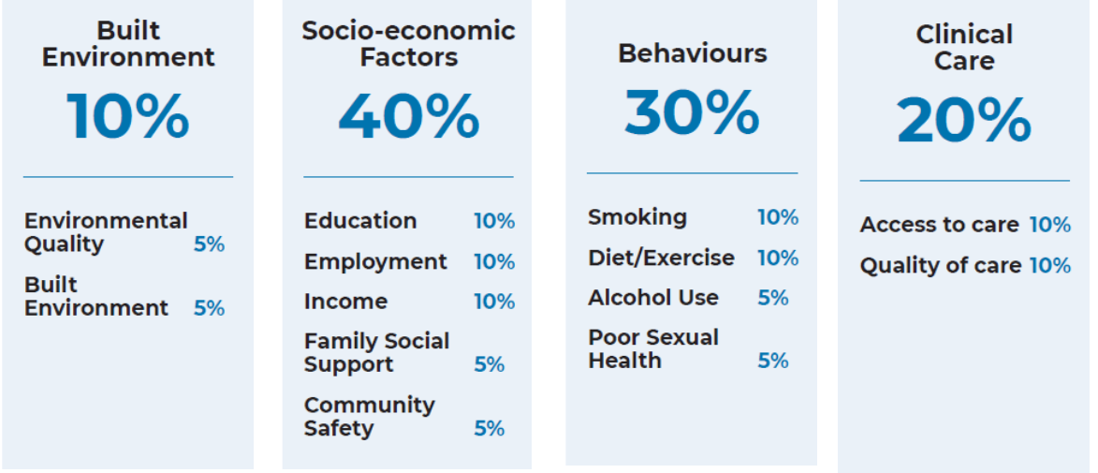
What drives health inequalities nationally?
Robert Wood Johnson Foundation and University of Wisconsin Population Health Institute
NHSE – Long term plan.

Slide 10
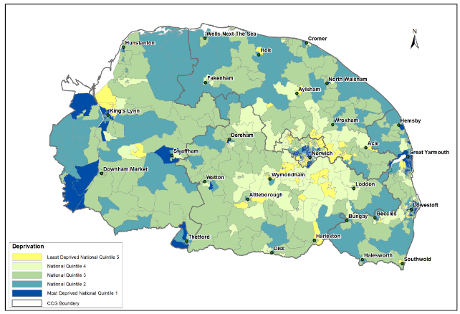

Slide 11
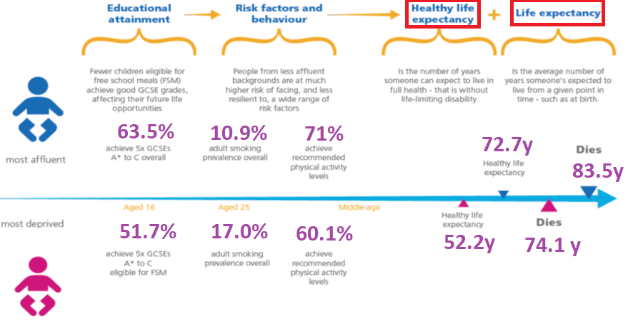
Variation by socio economic status
Adapted from: Southwark.gov.uk/publichealth using PHE PHOF data
Notes:
From population health Kevin Fenton PDF

Slide 12
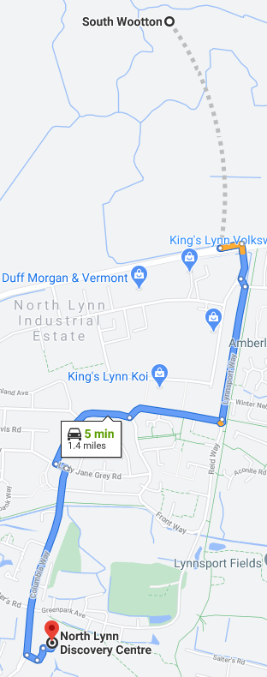
Example
You want to live here – Wootton:
Life expectancy 83 yrs male/ 86 yrs female
Healthy life expectancy 69 yrs male/ 71 yrs female
Fewer than 2 miles apart but a life expectancy gap of 8-9 years and a healthy life expectancy gap of 14-15 years
You don’t want to live here – North Lynn:
Life expectancy 75 yrs male/ 77 yrs female
Healthy life expectancy 55 yrs male/ 56 yrs female

Slide 13
Our five key health issues appear to be:
Hypertension
Obesity
Depression
Diabetes
Asthma
These are all broadly considered avoidable - they will be contributing to admissions & early mortality
Sources: PHE Fingertips, NCCG (GP data)

Slide 14
What the data doesn’t yet tell us!

Slide 15
Culture , Schemes and paperwork
Active Norfolk Resources
joanne.thompson@activenorfolk.org
https://www.youthsporttrust.org/
https://www.yourschoolgames.com/app/
https://www.afpe.org.uk/physical-education/afpe-quality-mark-for-pe-a-sport/

Slide 16
What are the barriers?
Resources
Staffing
Space
Weather
Excuses?

Slide 17
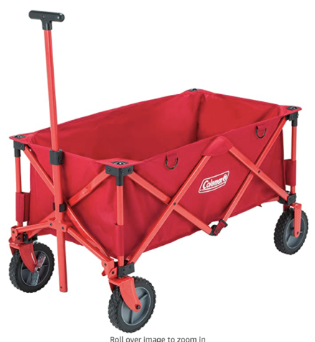
Resources

Slide 18
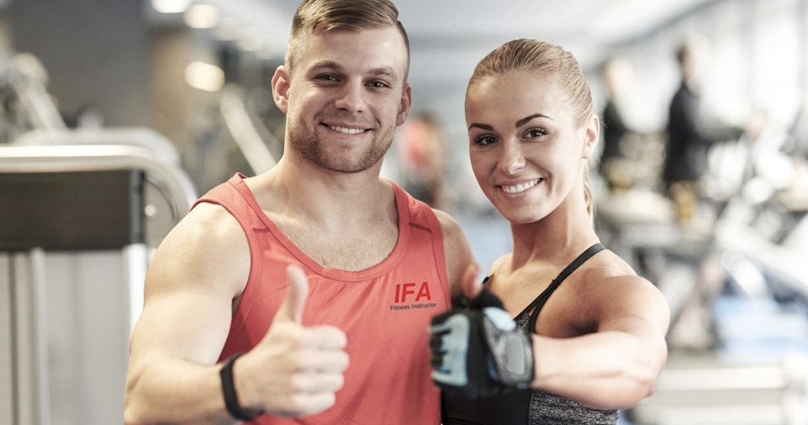
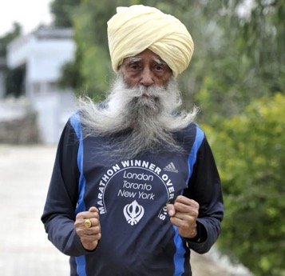
staffing

Slide 19
Space

Slide 21
Weather
Set the expectation.
What are the alternative?

Slide 22
Excuses

Slide 23
Health and wellbeing

Slide 24
Background
Year Group | Group Size | Coach | 5 1/2 weeks | Half Term | 6 Weeks
SEND GP Monday 9.40 – 10.10 am | SEN | JA | Sensory Circuits |  | Sensory Circuits
SEND GP Daily | SEN | HIVE STAFF | Sensory Circuits |  | Sensory Circuits
Yr 4/5 Monday 10.45 – 11.45 am | 31 | JA | Tag Rugby | 14th February 2021 | Football (3 wks)/ Kwik cricket
Yr 6 Monday 1.30 -3.15pm | 25 | JA | Tag Rugby | - 18th February 2021 | Football (3 wks)/ Kwik cricket
Yr 1 Tuesday 9.05 – 10.10 am | 28 | JA | Multi Skills – Balance & Co- ordination |  | Mini Tennis Skills
Yr 3/4 Tuesday 10.45 – 11.45 am | 25 | JA | Handball/ Netball (Playground) |  | Netball (Playground)
Yr 4/5 Tuesday 2- 3pm | 31 | JA | Hand ball/ Netball (Field) |  | Mini Tennis (Field)
Yr R Tuesday 1.25 – 1.55pm | 20 | JA | Football Fun |  | Multi Skills –Catching and Throwing
Yr 2/3 Wednesday (PPA cover 8.30 – 11.30am) | 25 | JA | Tag Rugby/Tri Golf |  | Tri Golf
Yr 6 1.30 -3.00pm | 12 (half group) | JA | Netball (Playground) |  | Mini Tennis (Playground)
Yr 2/3 Thursday 1 – 3.10pm | 25 | JA | Hockey |  | Multi Skills – Catching & Throwing
Yr 6 Friday 9 – 10.15am | 12 (half Group) | JA | Netball (Playground) |  | Mini Tennis (Playground)
Yr 3/4Friday 10.45 -11.45am | 25 | JA | Hockey/Tri Golf |  | Tri Golf
Yr 1 Friday 1.15 – 3pm | 28 | JA | Multi Skills – Catching & Throwing/ Tri Golf |  | Tri Golf
Yr 4/5 9 -3.00pm | 15 (half Group) | ICS Coaching | Multi Skills/Social skills |  | Multi Skills/social skills
Other/ Competition Dates | Friday’s AM – Dance TBC | Yr 5/6 Kwik cricket 17/5/22 | Yr 3/4 Bee Netball tournament 29/3/22 | Yr 1/2, 3/4 Tri Golf festival 17/3/22 | Yr 5/6 09/02/22 Tag Rugby festival

Slide 25
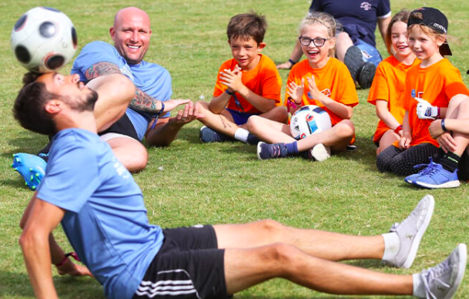
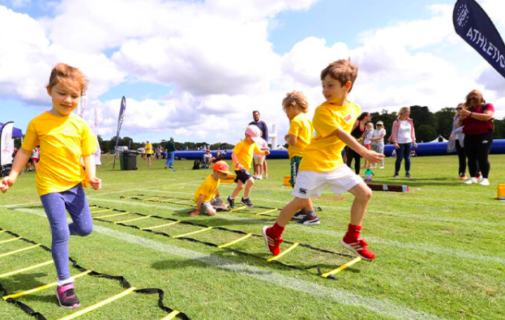
Club links and opportunities

Slide 26
Covid 19

Slide 28
Key Takeaways
Use an audit tool such as the School Games Mark/afPE Quality Mark to ensure your provision is good.
Use the ‘Evidencing the Impact of PE’ document from the Youth Sports trust to ensure your paperwork is in order and your sport premium accounted for. https://www.youthsporttrust.org/
Be wary of schemes. Make sure someone is monitoring them regularly? Are children moving enough? Do they go outside often enough, for long enough?
Look at resources and ask your PE Co-Ordinator for a wish list. Is there a good space to store resources? Are they accessible? Do you have a good pump for balls? Do you need a trolley?
Look at the timetable. Is PE happening often enough for every year group? Daily mile/workout, lunch activity, after school clubs, yoga, dance, forest schools……
What is your wet weather plan? Speed stacking, table tennis, air footie, table top games?
Do you participate in Cluster events and intra school events? Just take a risk and sign up.
Make sure senior leadership is involved in monitoring.
Are you really prepared to give something up that is good to do something even better! Can you afford not to?

