Slide 1

RE Update
RE Update September / October 2021

Slide 2
RE Update
REreads – Katie Gooch NATRE (Eastern Region)
https://docs.google.com/document/d/1FgiMS9WTM4ncX0UIyF0riTW6EWy7O74tbKFdI_sLLtQ/mobilebasic
Follow Katie on twitter: @goochkt
Provides a comprehensive ‘go to’ list of high quality, easily accessible reads linked to all things RE. Some of very short, other longer.

Slide 3
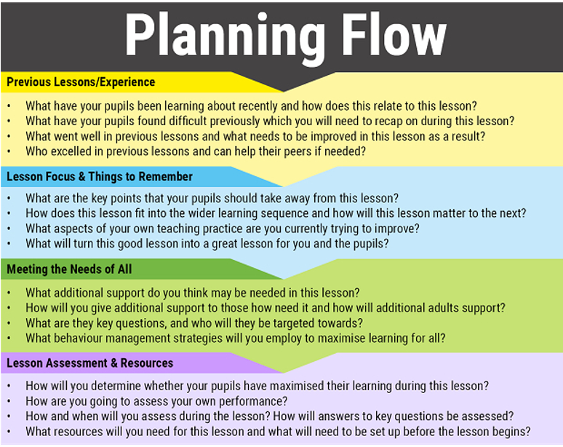
RE Update
A good checklist to think about when delivering RE lessons.
Particularly useful when introducing new concepts or beliefs that children may find hard to understand.

Slide 4

RE Update
Strictly RE is back! NATRE will be hosting its national annual conference online for your convenience and peace of mind while still giving you everything you love about Strictly RE without having to leave your home.
Keep your eyes peeled for Strictly RE updates on our website!

Slide 5
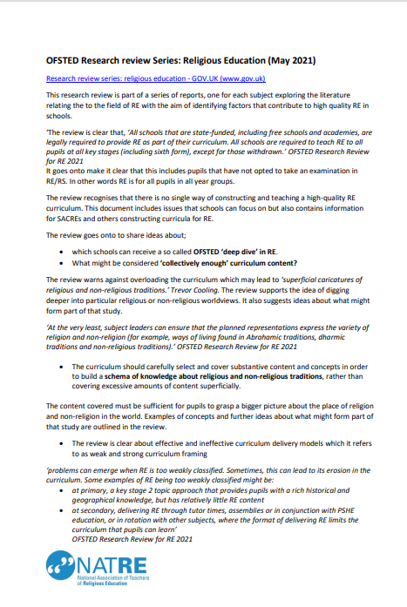

RE Update
NATRE have produced a two page digest of the Ofsted Research Review in Religious Education.

Slide 6

RE Update
www.therepodcast.co.uk
An excellent bitesize podcast on religion, ethics and philosophy.

Slide 7

RE Update
In Conversation
Our ‘In Conversation’ events began as a series of free virtual seminars bringing researchers and teachers together through conversation on topics linked to RE.
You can find out about and book for future events at
https://www.cstg.org.uk/activities/events/

Slide 8


RE Update

Slide 9

RE Update
Bibledex
www.bibledex.com

